Slide 2






The Fabric Playbook: Managing, Maintaining & Delivering

Slide 3





Hylke Peek
Data Consultant
I’m working on a lot of different stuff. Focus on Azure, Fabric, and Power BI.
Data Platform
Data warehousing
Analytics
Azure data solutions
linkedin.com/hylkepeek
github.com/hylkepeek
PeekData.nl

Slide 4
Agenda
Building blocks
Administration
10:50 – 11:20 - Break
Security
13:10 – 14:10 - Lunch break
Data Governance
Development
15:45 – 16:15 - Break
Recap

Slide 5

Building blocks

Slide 6
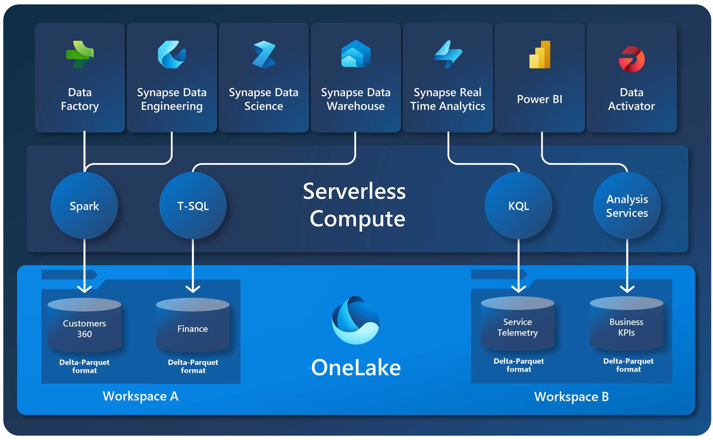
Understand Fabric architecture
Single SaaS lake
Provisioned automatically with the tenant
All workloads automatically store data in OneLake workspace folders
All data is organized in a hierarchical namespace
Data in OneLake is automatically indexed for discovery, MIP labels, lineage, PII scans, sharing, governance and compliance

Slide 7
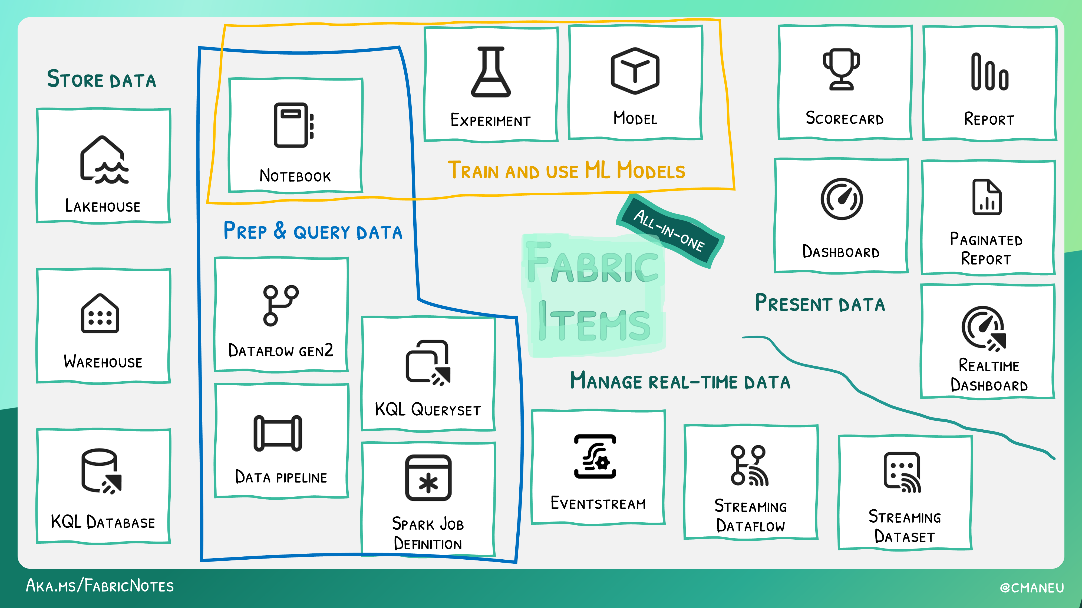

Slide 8
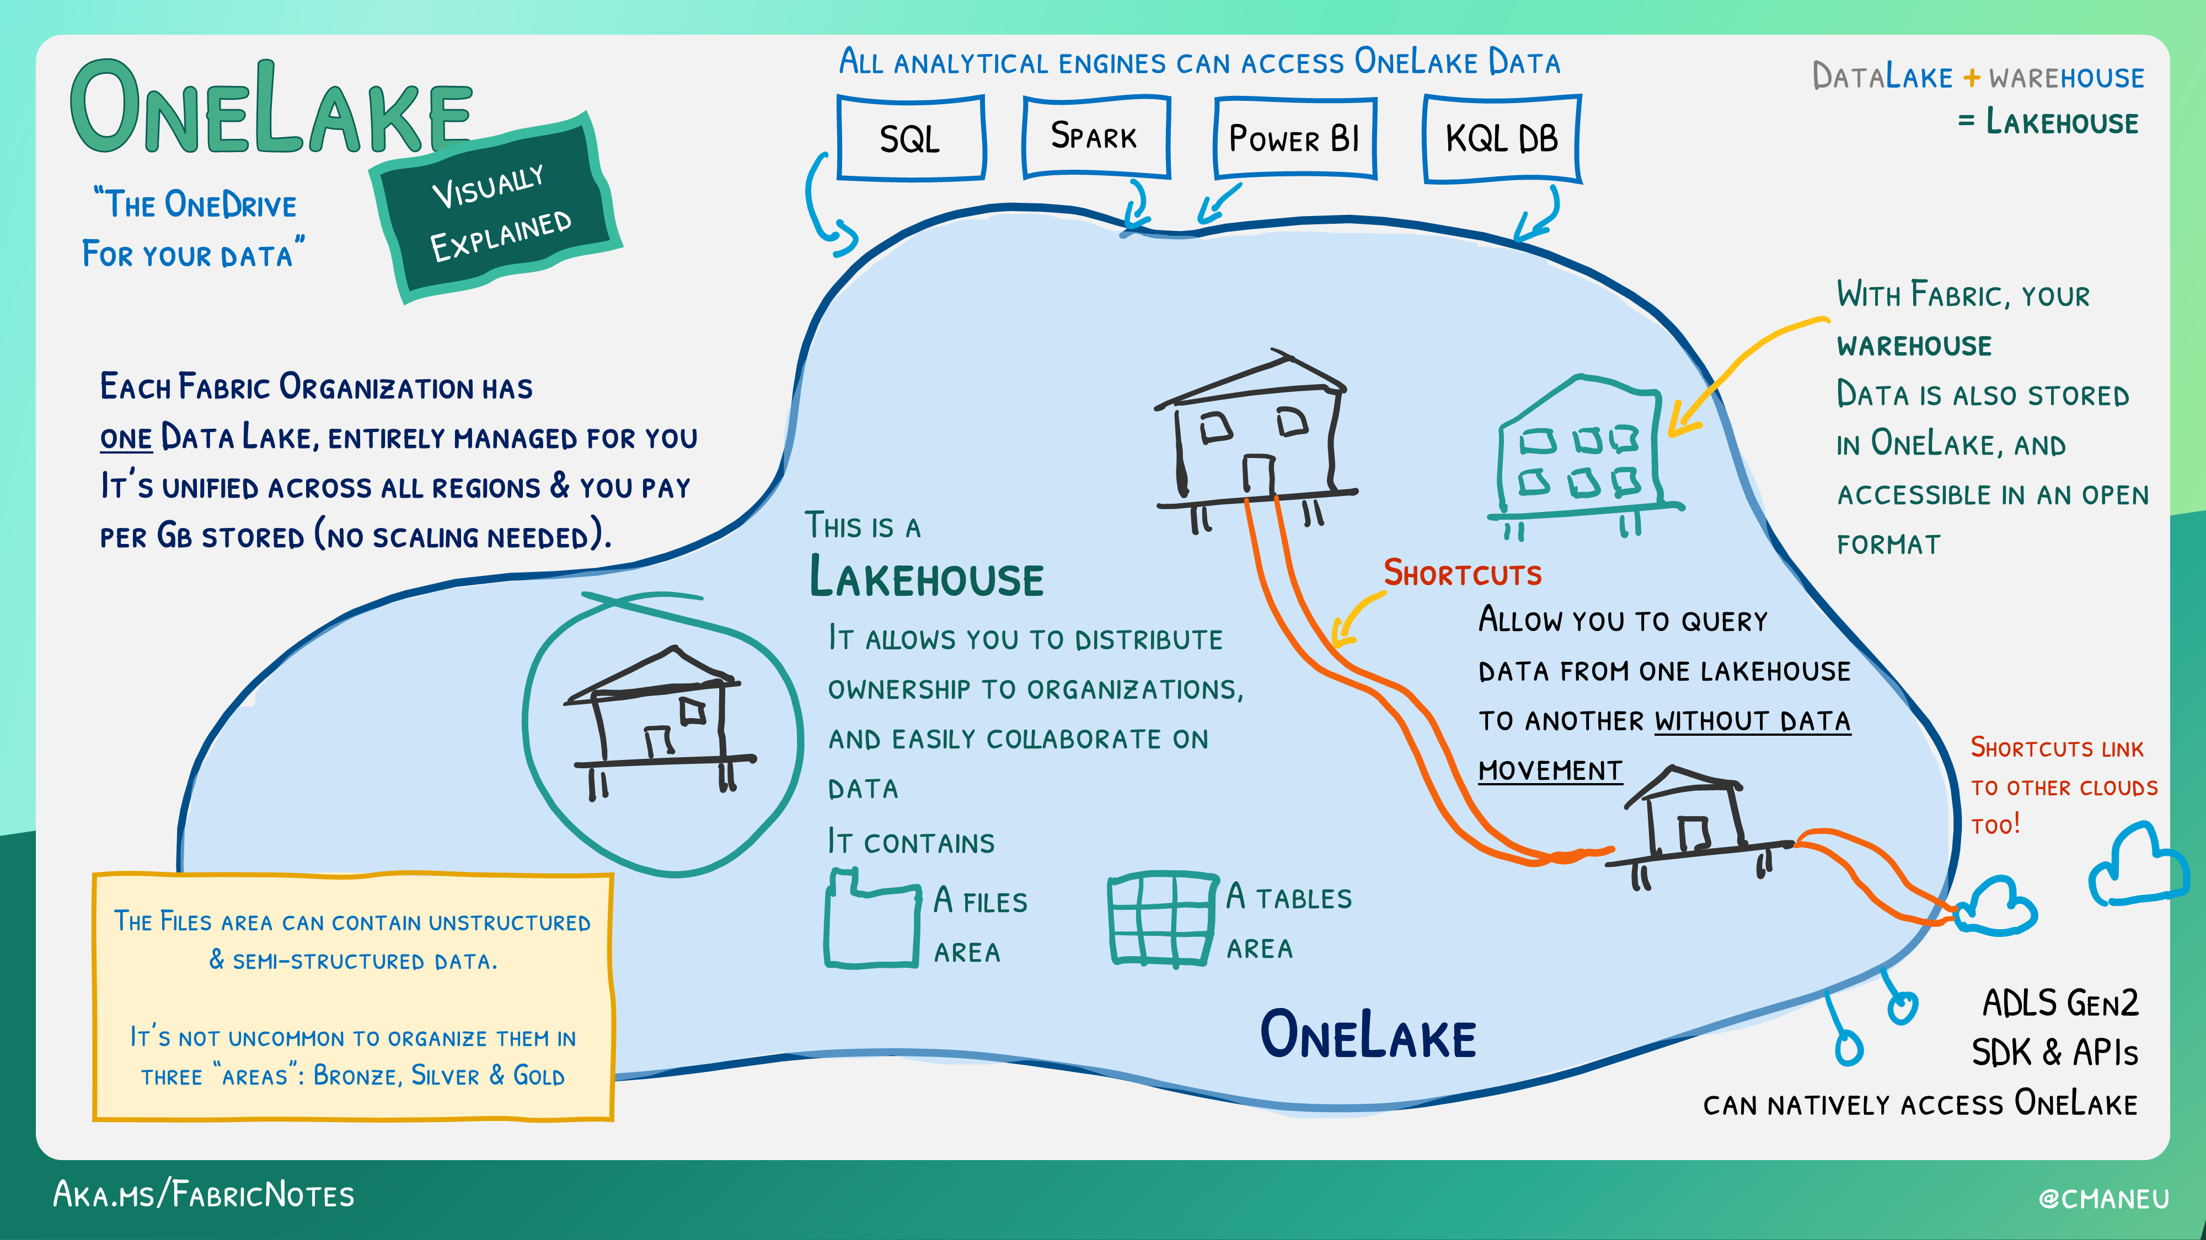

Slide 9

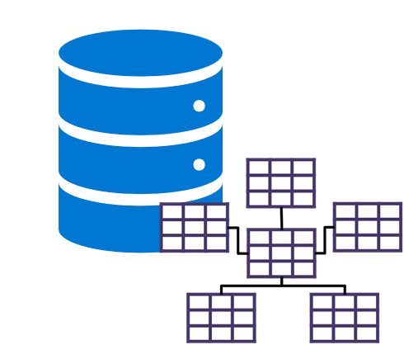

Lakehouse vs. Warehouse
Data Lake
Data Warehouse
Scalable, distributed file storage​
Flexible schema-on-read semantics​
Big data technology compatibility​
Relational schema modelling​
SQL-based querying​
Proven basis for reporting and analytics​

Slide 10

Lakehouse vs. Warehouse
Warehouse
Structured data
Multi-table transactions
High performance on complex queries and large data volumes
Expansive security (object-level, DDL/DML, dynamic data masking)
T-SQL, Spark
Lakehouse
Semi-structured or unstructured data
Scalable and cost-effective
Supports Delta Lake features
T-SQL security (row/table level)
T-SQL, Spark (Scala, PySpark, Spark SQL, R)
Large-scale data processing and analytics, including machine learning and predictive modelling
Centralized location for data engineers, data scientist, and data analysts

Slide 11

SQL Analytics Endpoint
‘Turn your lakehouse into a SQL datawarehouse’
Put a warehouse on top of your Lakehouse
Query the tables that reference data in your Delta Lake folders in the lake
Create views, inline TVFs, and procedures to encapsulate your semantics and business logic in T-SQL
Manage permissions on the objects
No DML

Slide 12
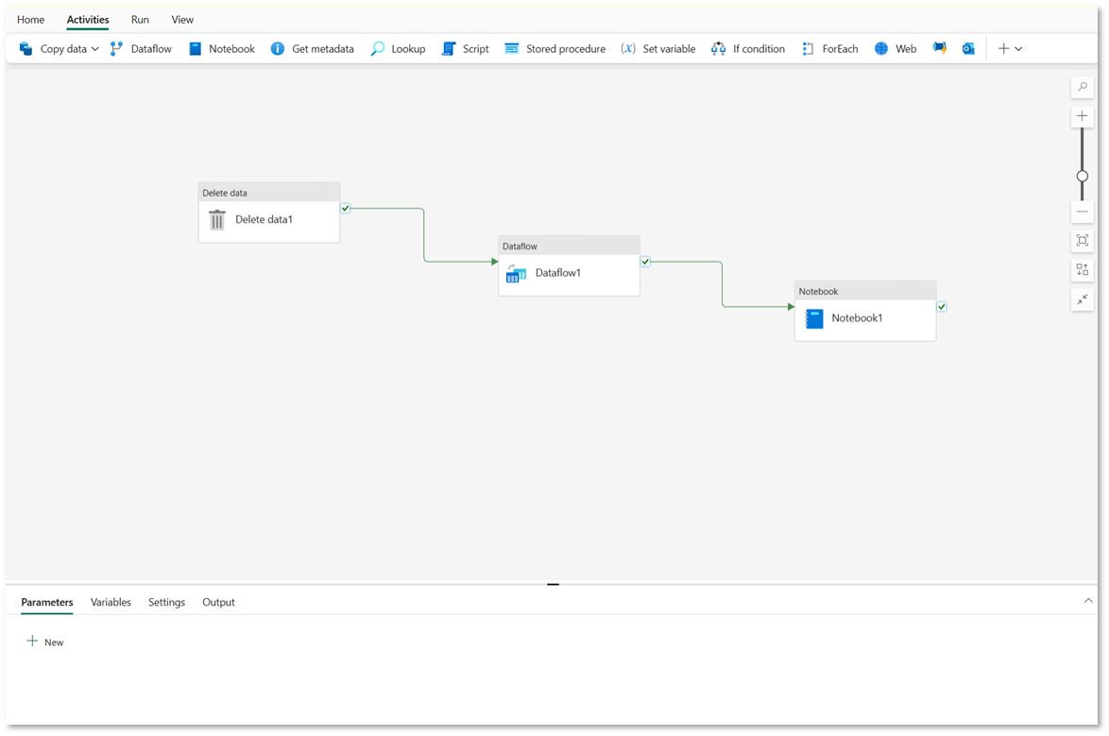
Pipelines
Pipeline concepts
Activities
Data transformation
Control flow
Parameters
Pipeline runs

Slide 13
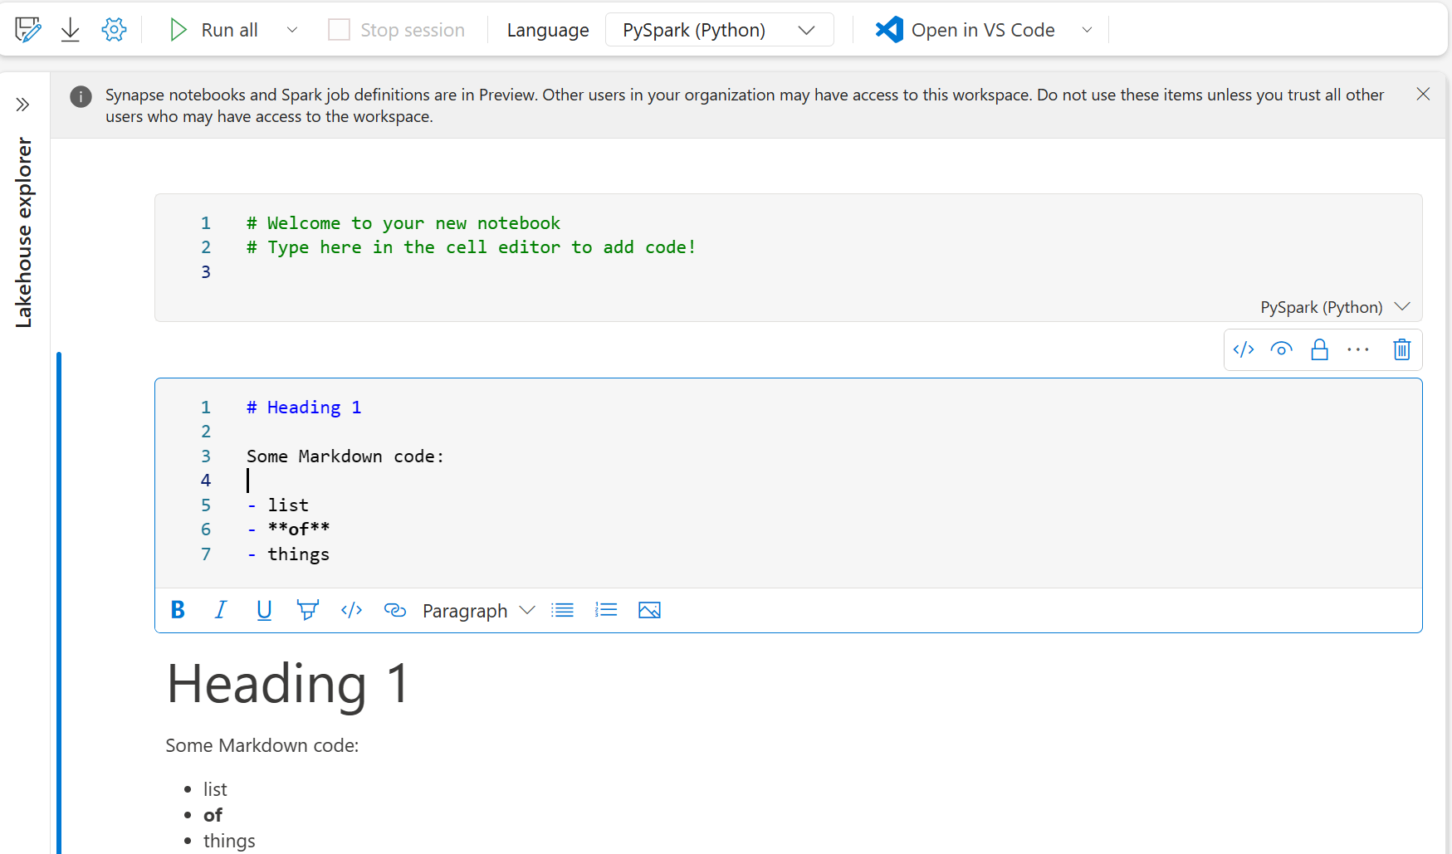
Fabric notebooks
Fabric notebook concepts
Code (PySpark, Scala, R, Spark SQL)
Markdown (comments)
Run individual or multiple cells
Ingest and transform
Support automation

Slide 14
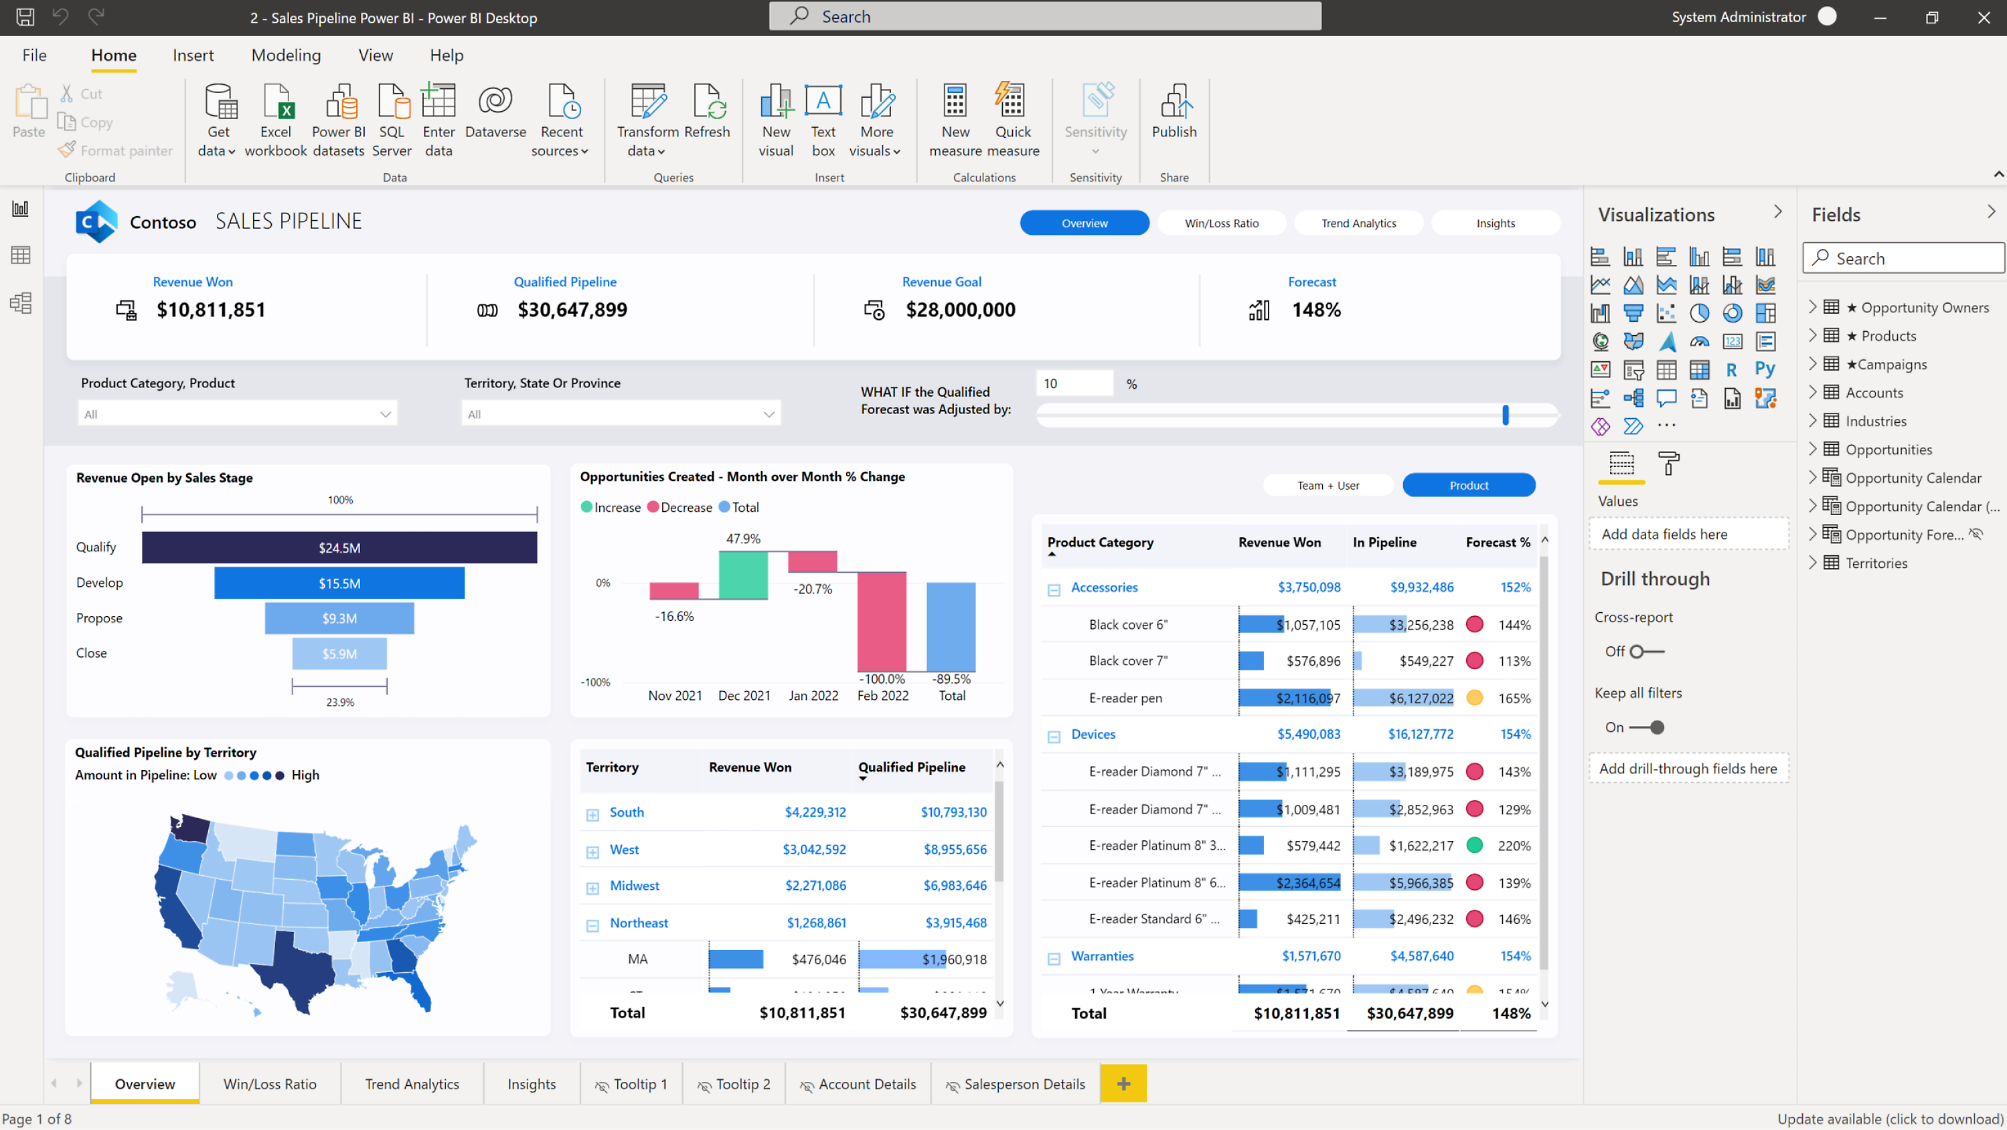
Power BI
Data analytics and visualization environment for business users
Semantic model
Ingest data from Fabric and other sources
Model relationships, hierarchies, measures etc.
Create scalable dataset for performance optimization
Report
Transform data to actionable insights
Create standardized reports
And many more…
Sharing inside and outside the organization
Streaming datasets
Power Query
…

Slide 15
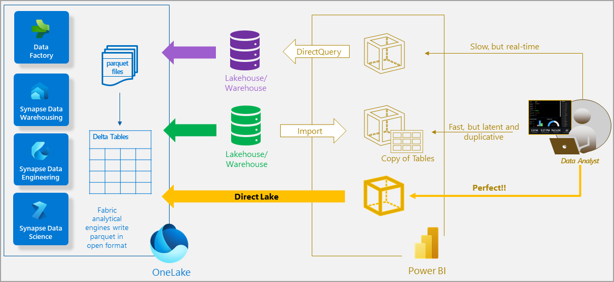
Power BI – Direct Lake mode
microsoft.com

Slide 16

Copilot
General available
Power BI
Preview
Data Engineering, Data Science, Data Factory, Data Warehouse, and Real-Time Intelligence
Considerations
Data maybe processed outside your capacity’s geographic region
Capacity admins can also manage this setting
Not available in all regions yet
Data Science and data engineering
Code completion, automate routine tasks, contextual code suggestion, support on errors
Data factory
Code generation and code explanations
Data warehouse
Natural Language to SQL, code completion and quick actions
Real-time intelligence
Natural Language to KQL
Power BI
Generates reports, summary’s, Q&A, write DAX

Slide 17
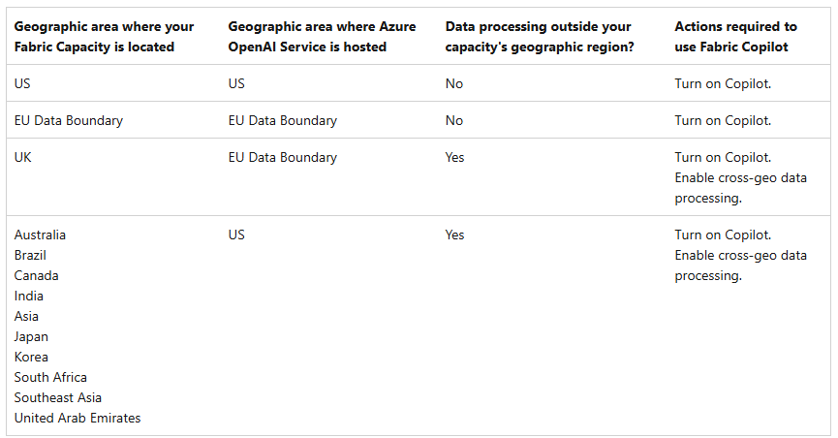
Copilot processing

Slide 18

Administration

Slide 19
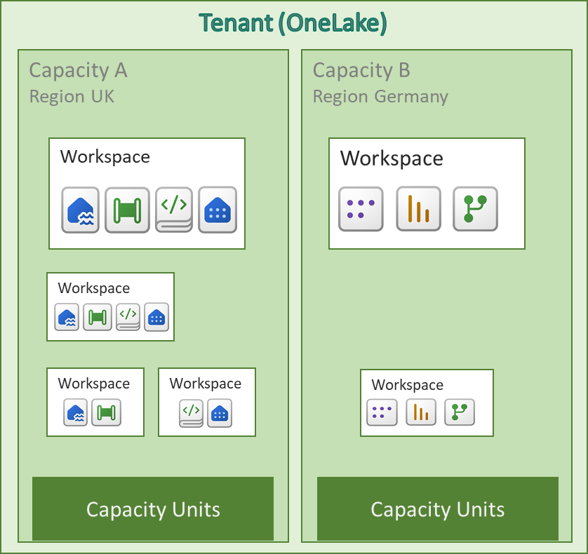
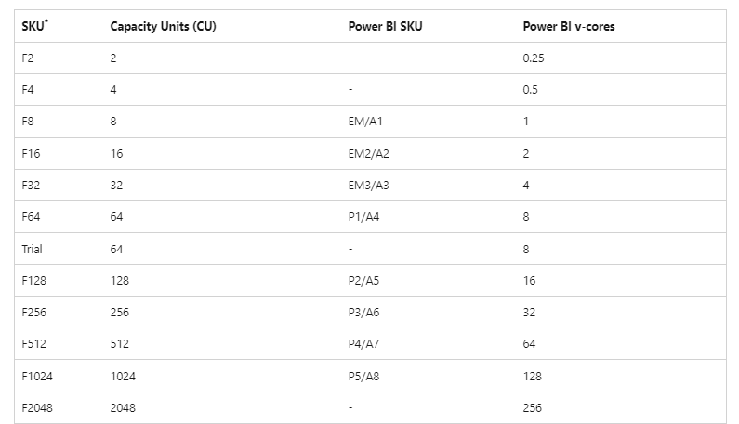
Licensing concepts
Tenant
One tenant with one OneLake
Capacity
Your own distinct pool of resources
Workspace belongs to one capacity
You can have multiple capacities
SKU’s
Corresponds to a amount of compute power, measured in Capacity Units (CU’s)

Slide 20
Fabric licensing
PowerBI
Copilot support | SKU* | Capacity Units (CU) | Power BI SKU | Power BI v-cores
No | F2 | 2 | - | 0.25
No | F4 | 4 | - | 0.5
No | F8 | 8 | EM/A1 | 1
No | F16 | 16 | EM2/A2 | 2
No | F32 | 32 | EM3/A3 | 4
Yes | Trial | 64 | - | 8
Yes | F64 | 64 | P1/A4 | 8
Yes | F128 | 128 | P2/A5 | 16
Yes | F256 | 256 | P3/A6 | 32
Yes | F512 | 512 | P4/A7 | 64
Yes | F1024 | 1024 | P5/A8 | 128
Yes | F2048 | 2048 | - | 256
Consumers
Power BI license required
Creators
Consumers
Power BI license Free for viewer role
Creators
Power BI license required

Slide 21

Trial license
What you get
A free Fabric capacity (F64) for 60 days
1 TB of OneLake storage
The most features
What you don’t get
Trusted workspaces
Private links
Considerations
You have a limit of free licenses in one tenant
F64 +
Not available in all regions yet

Slide 22
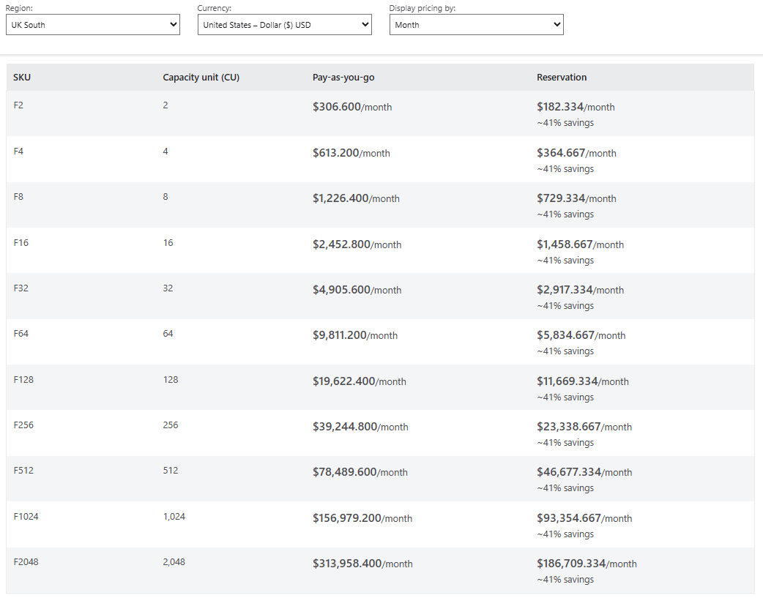
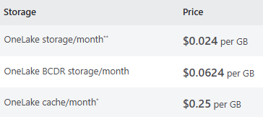
Pricing
Where do you pay for?
Fabric Capacity
OneLake Storage
Per-user licenses
Networking (future)
Fabric Capacity
OneLake storage
Per-user license
Pro – $14 user/month
PPU – $24 user/month

Slide 23







Domains
Logical groups of Fabric items
Organize and manage data according to your business
Group Fabric item into logical groups
Assign workspaces to groups, bulk assignment and one at the time
Control by using new roles: Domain admin and contributor
Managed within the admin portal
Microsoft Fabric (OneLake)
Capacity
Capacity
Domain
Workspace
Workspace
Domain
Workspace
Domain
Workspace
Workspace
Workspace

Slide 24


Yes, you can put everything in 1 workspace, but you don’t want to!
Workspace best-practice
There’s no one way, it depends on…
Permission
Who works on which items?
Workspace contributor (and higher) can edit all items within the workspace. You don’t want to give a report builder edit permissions to a data pipeline.
Data security
Who is allowed to see which data?
Workspace contributor (and higher) has access to the underlying data. Data security like RLS doesn’t apply.
Development process
Which environments do you need (dev, test, acc, and prod)?
You might have different users for each environment.
Deployment process
Which items should be deployed together?
You might have different deployment policies and/or frequency.

Slide 25
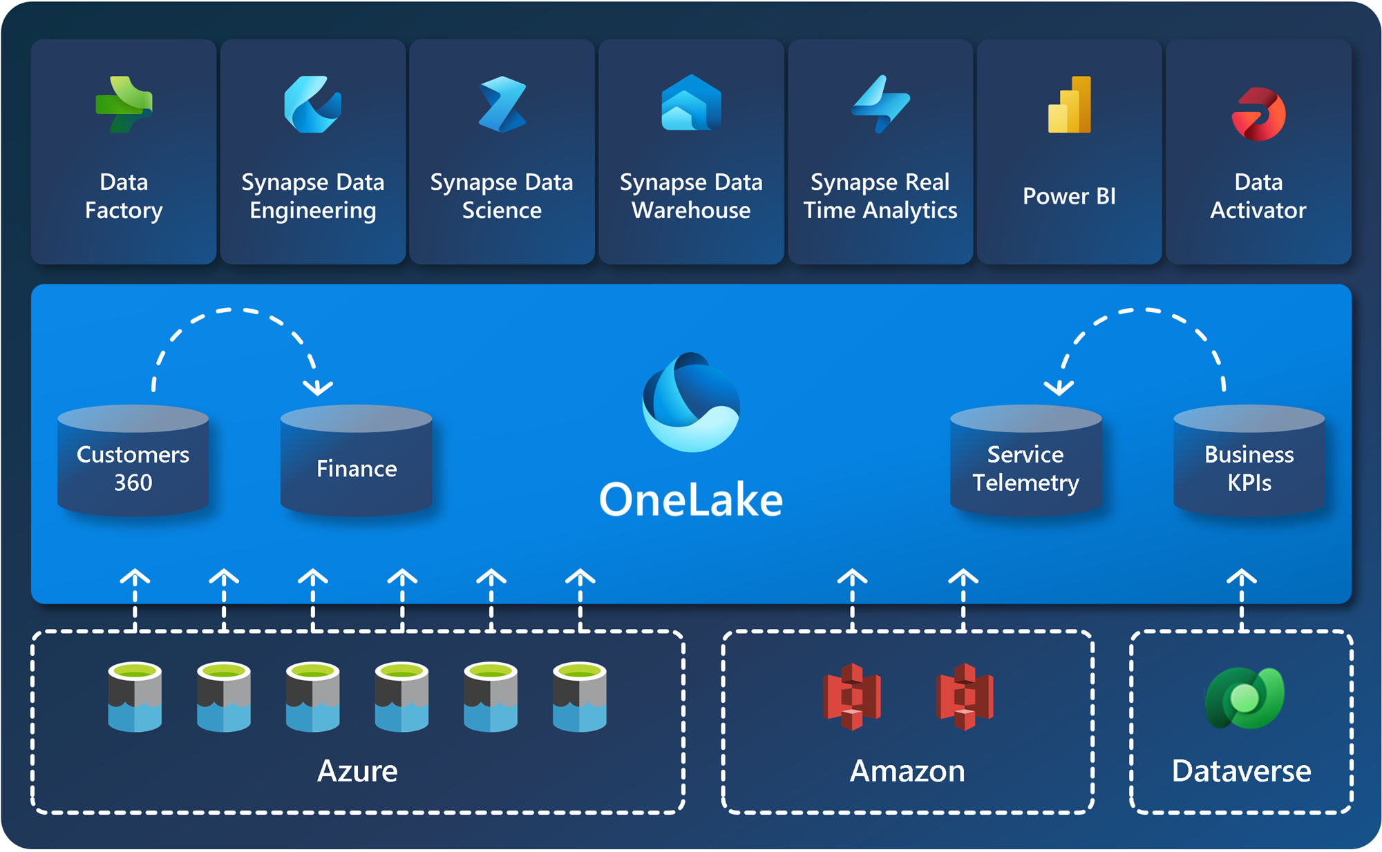
OneLake Shortcuts
Extend your lake with virtual data
What is it?
Artifacts that point to other storage locations (folder), so you can add data from other sources
It’s virtual, so it doesn’t copy data
Shortcut types
Internal
Link to other Fabric items like Lakehouse, KQL database and Warehouse
You can cross item-types and workspaces
External
Link to ADLS Gen2, Amazon S3, Google Cloud Storage, and Dataverse
Caching occurs for Amazon S3 and Google Cloud Storage

Slide 26
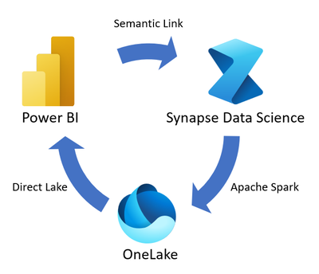
Semantic Link
Bridges Power BI semantic models with Synapse Data Science
Why use it?
Seamless Integration
Preservces Semantic Information
Reuse business logic (relationships, hierarchies, measures)
Core components
SemPy Library
FabricDataFrame
Use cases
Data validation
Predictive modelling on enriched data
Reuse data without duplicating
microsoft.com

Slide 27

Bursting, Smoothing and Throttling
Bursting and Smoothing
Use more resource (CU’s) than the capacity limit – Using future CU’s
Handling spikes
Job classification
Interactive: Short-term spikes
Background: Long-running high demand

Slide 28
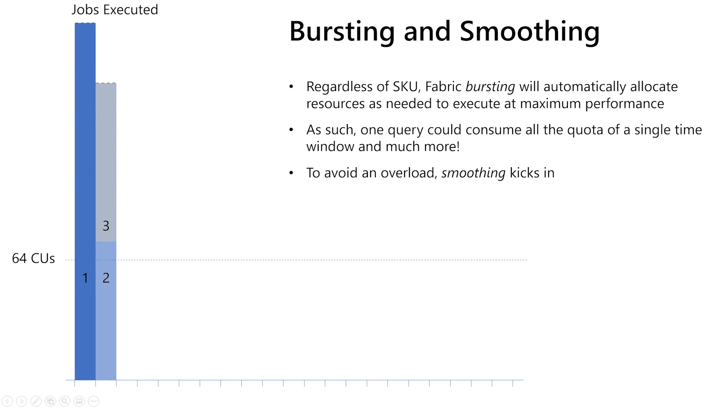
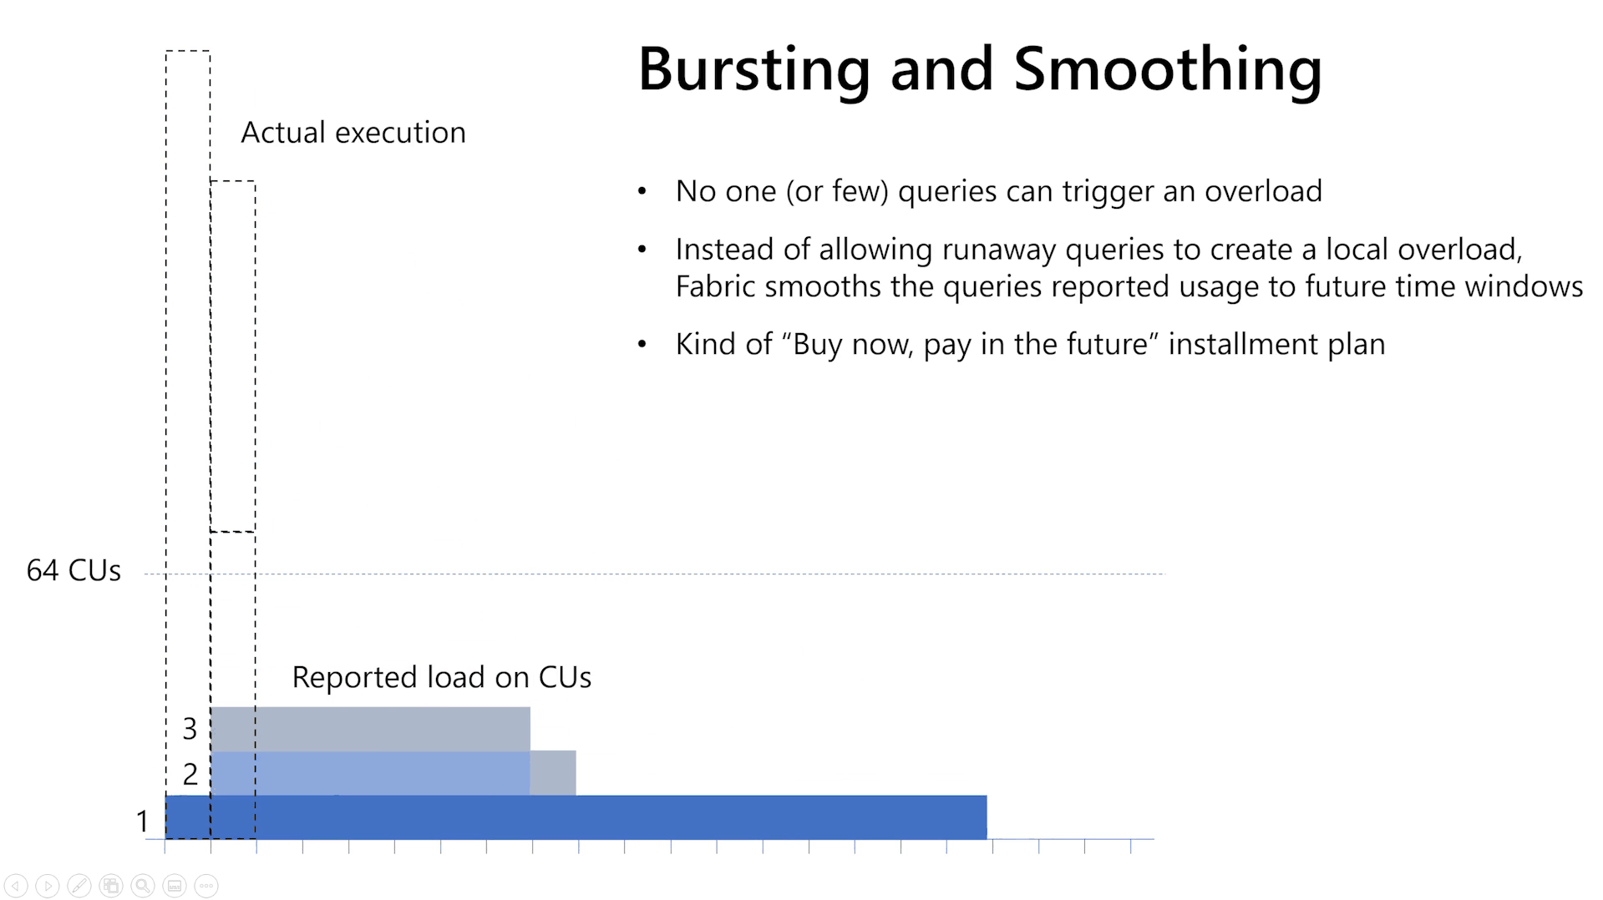
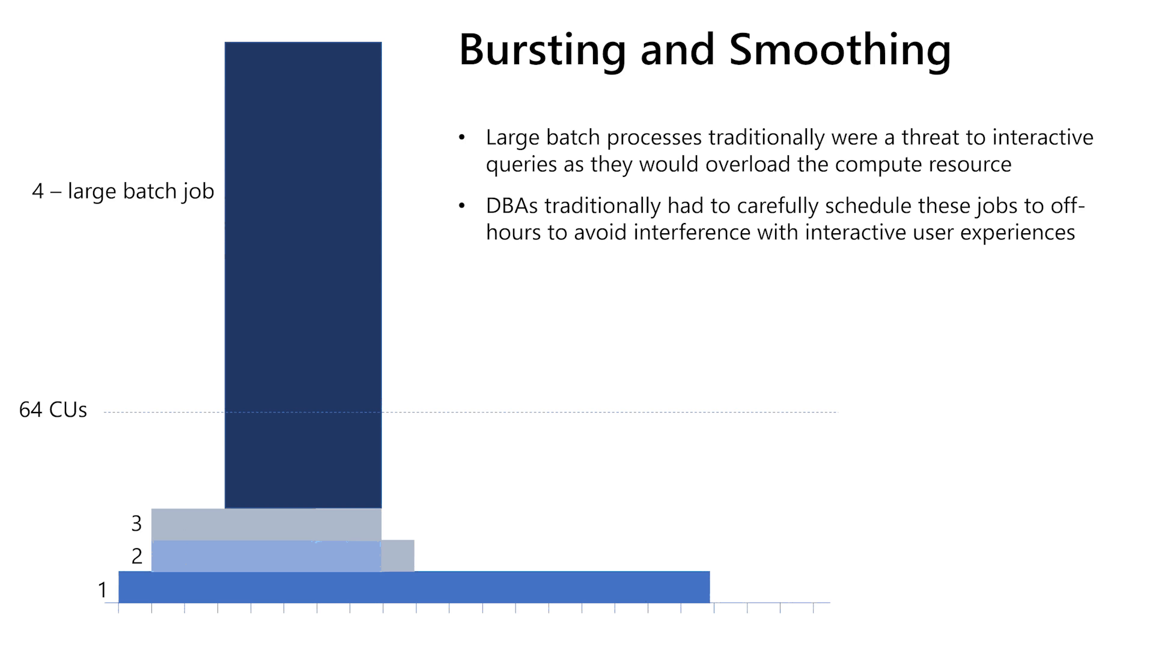
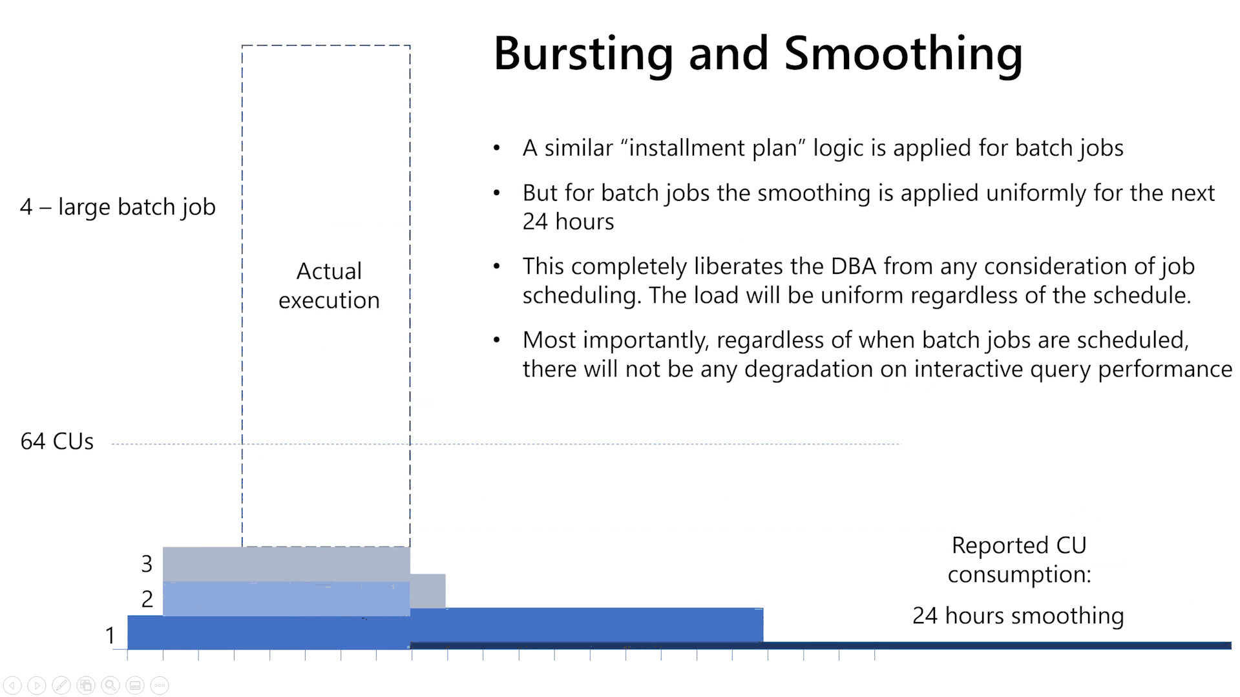
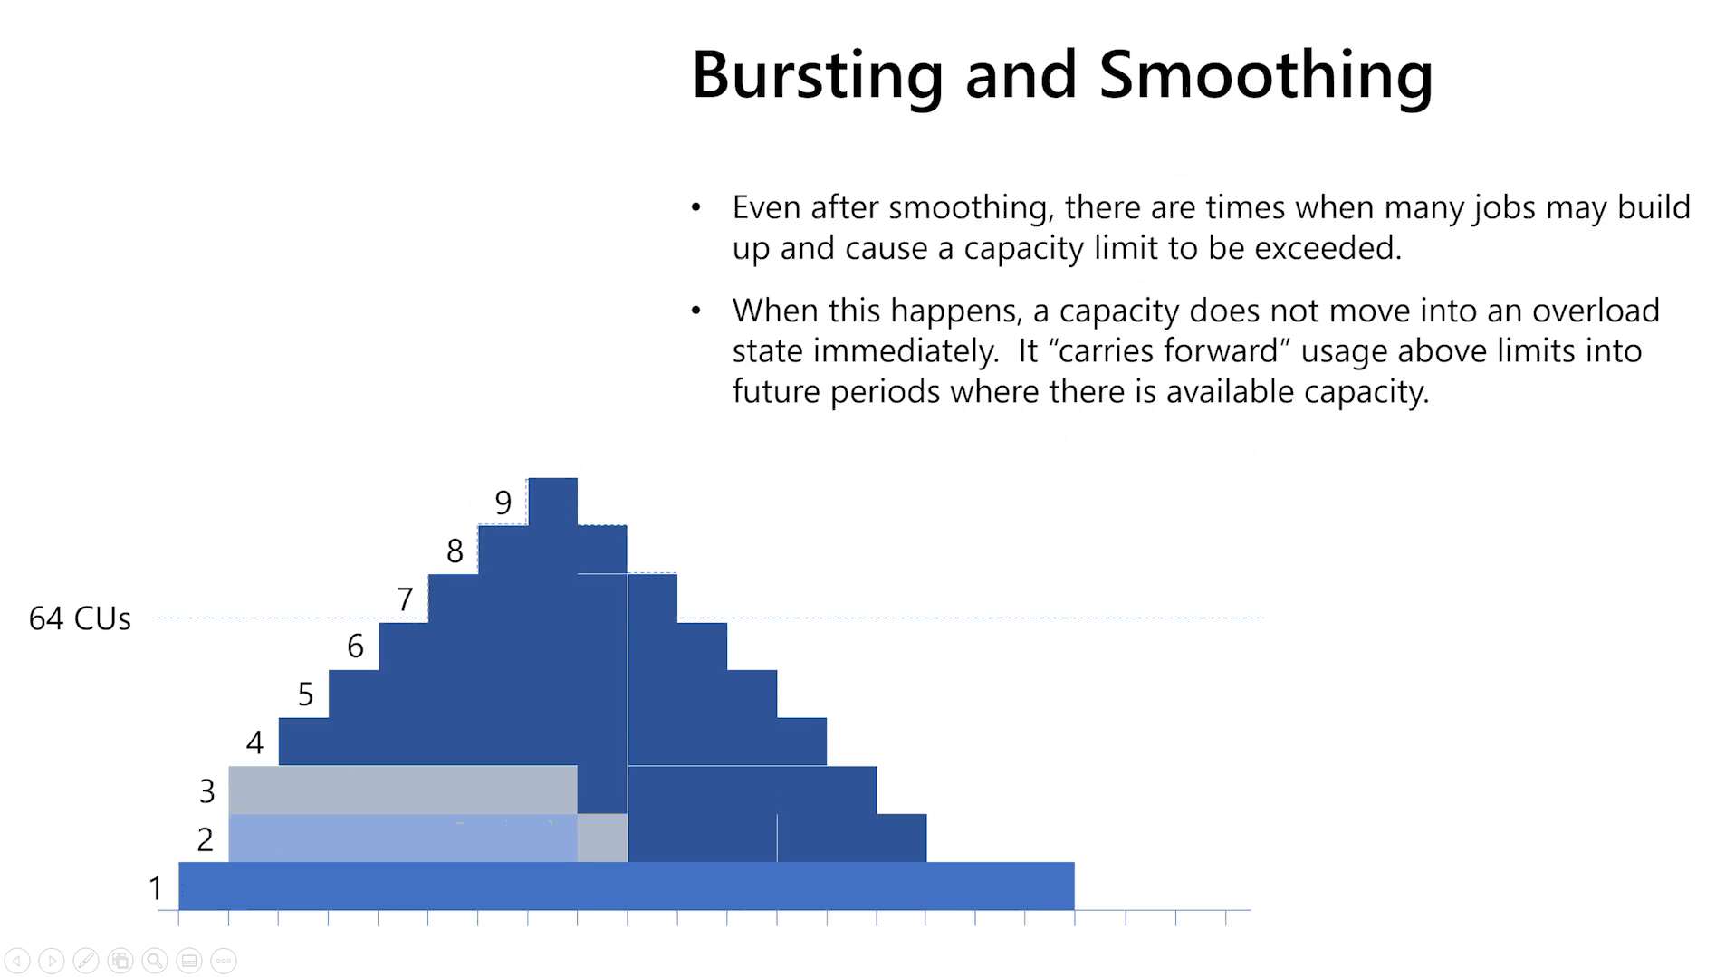
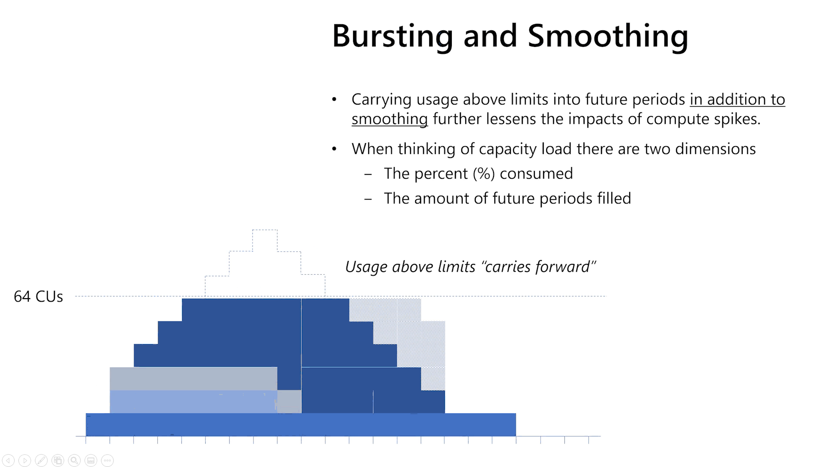

Slide 29
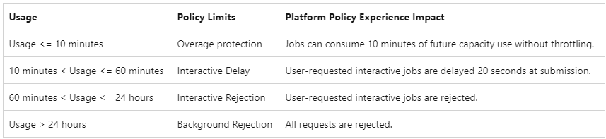
Bursting, Smoothing and Throttling
Bursting and Smoothing
Use more resource (CU’s) than the capacity limit – Using future CU’s
Handling spikes
Job classification
Interactive: Short-term spikes
Background: Long-running high demand
Throttling
Compensating smoothing
Degraded user performance

Slide 30
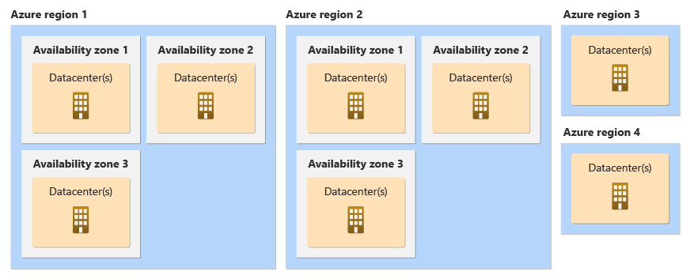
Resiliance

Slide 31
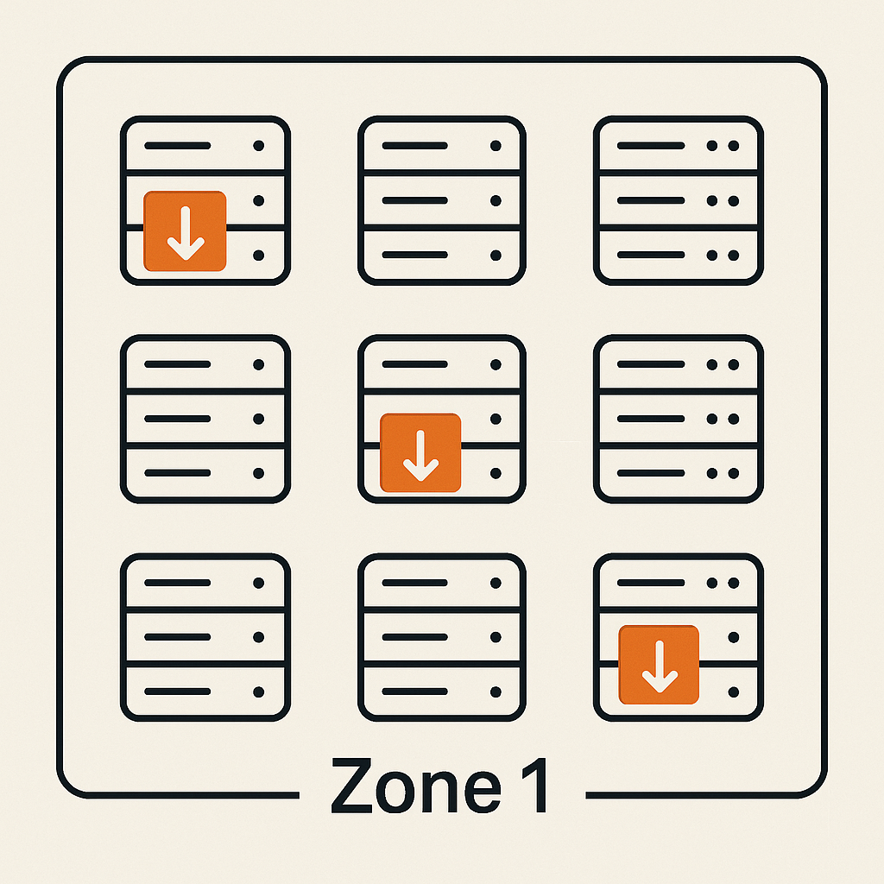
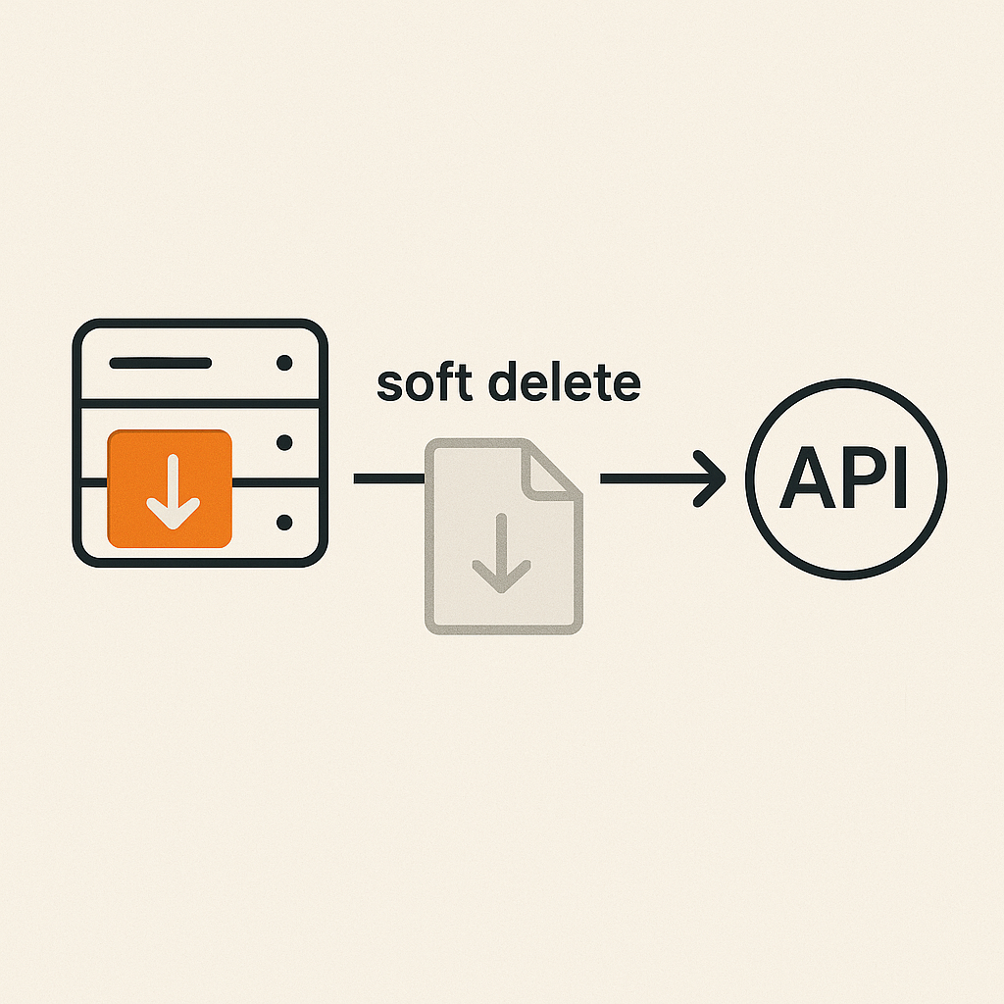
Resiliance
Zone redundant support
Power BI is always covered by zone redundancy
Other items depends on the region
Soft deletion
7 days before permanent deletion
Use REST APIs, Azure Storage SDKs, and the Azure PowerShell

Slide 32

Resiliance
Warehouse – Clone tables
Copy the metadata of the warehouse
Microsoft Fabric (OneLake)
Use-cases
Development purposes
Consistent reporting
Support other processes like ML
Table
Table-clone
Considerations
Only available within the warehouse
Not available for SQL analytics endpoint
Clone tables, not warehouse or schema
Parquet files

Slide 33
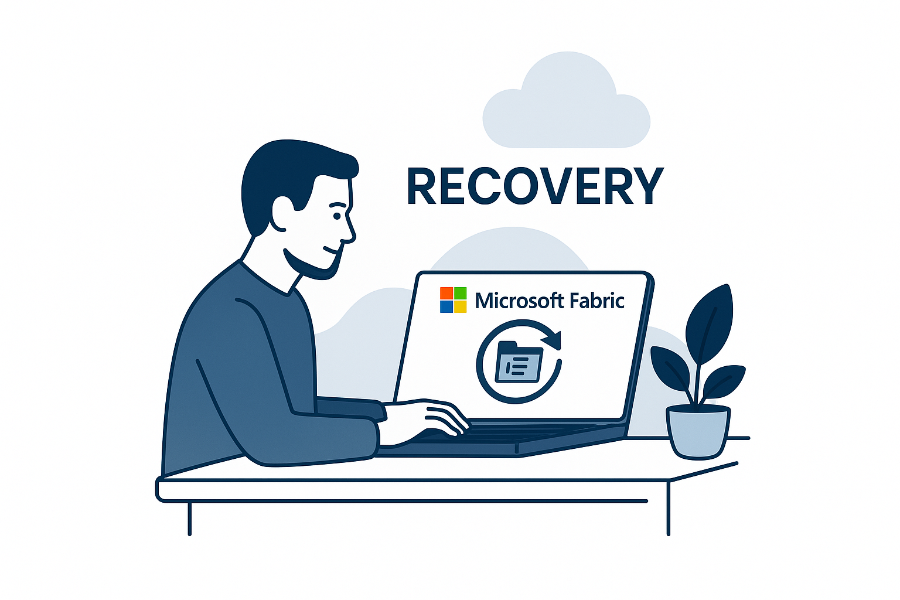
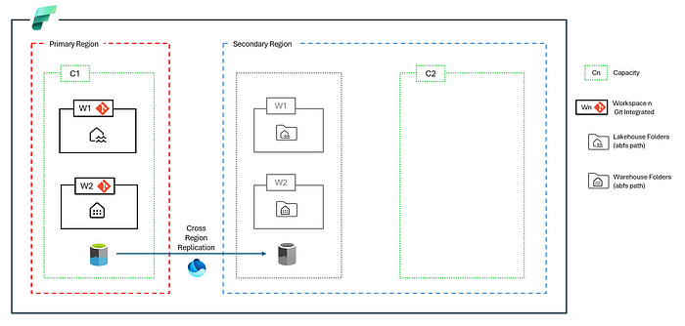
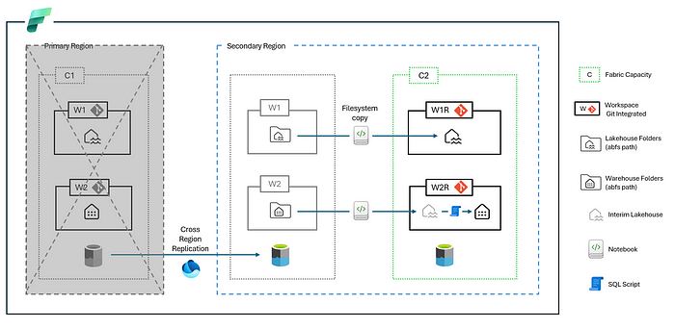
Recovery
Disaster Recovery
DR feature in capacity
Copy files to secondary region
Data is moved to other region
Recovery is not an automated process
Nicholas Hurt
Nicholas Hurt

Slide 34
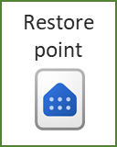
Recovery
Warehouse – Restore in place
Microsoft Fabric (OneLake)
Use-cases
Database corruption
Development purposes
Failed releases
Workspace
Metadata
Considerations
Automatically created every 8 hours
Create manually (before pause)
30 days retention period
Parquet files

Slide 35
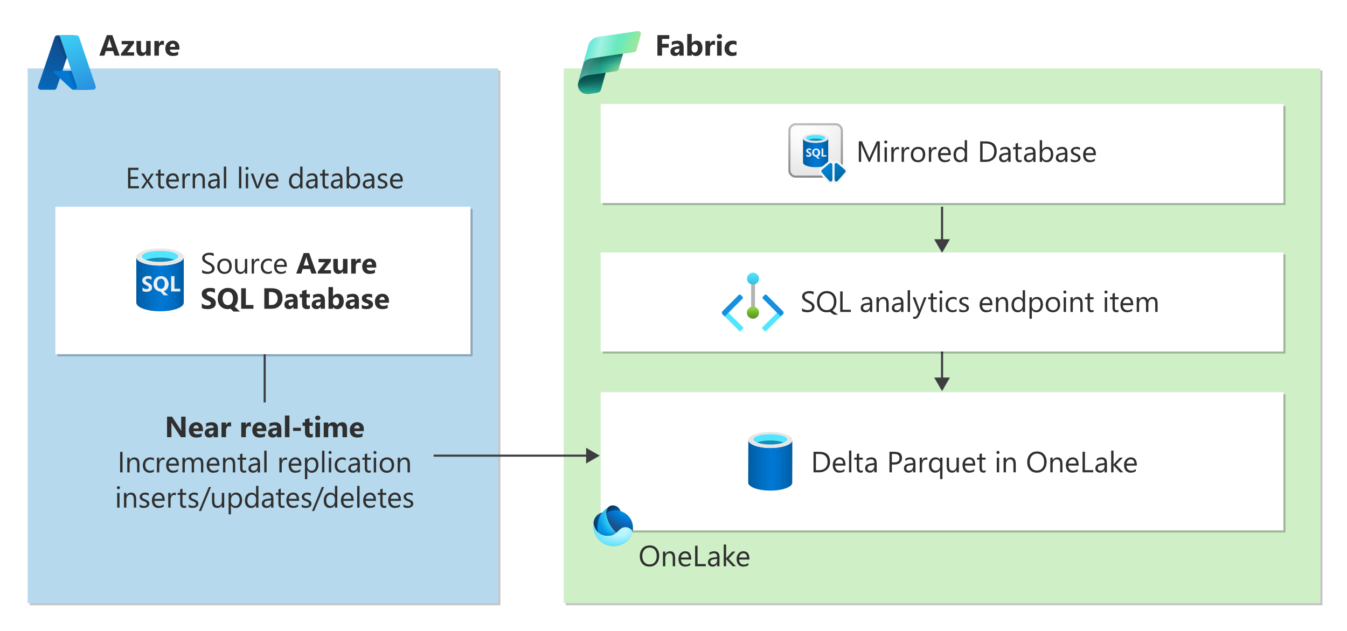
Mirroring
Near-realtime replication
Use-cases
Data engineering
Data science
Reporting
Database mirroring
Metadata mirroring
Open mirroring
microsoft
Azure SQL Database
Azure Cosmos DB
Azure Databricks
SQL Database
Snowflake

Slide 36
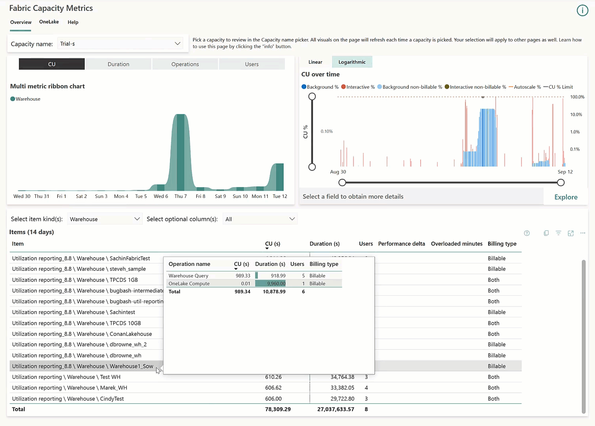
Fabric capacity metrics app
Monitor your capacities
Charts display capacity usage over a 14-day period
Helps you understand which workloads use more capacity
Essential for
Informed decisions on how to use your capacity resources

Slide 37
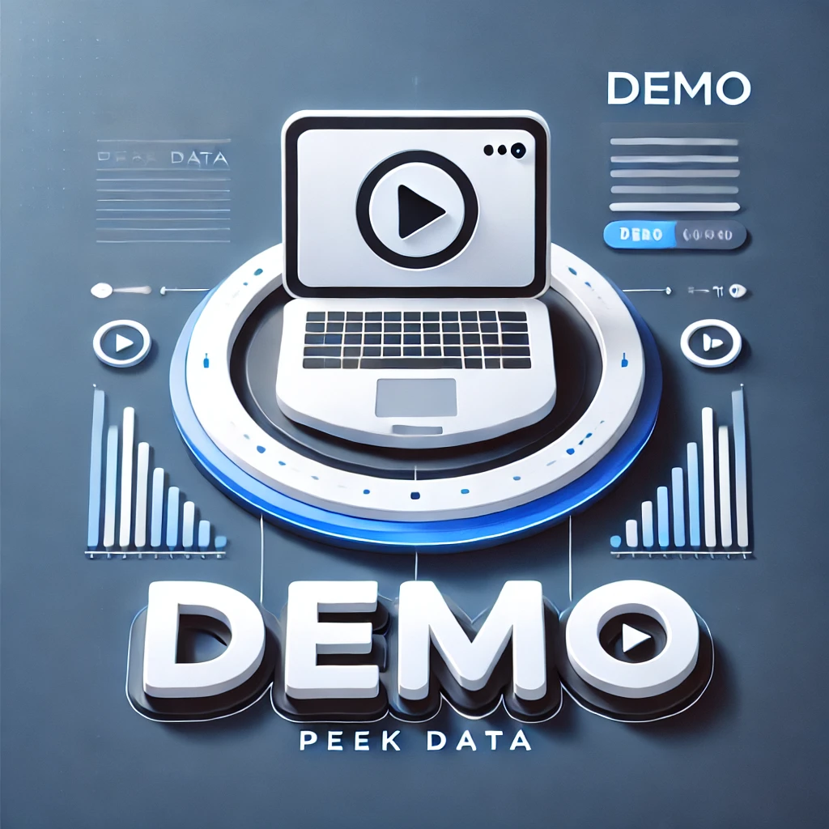
Admin portal
Domains
Shortcuts

Slide 38

Building blocks and Administration
Assignment (2 or 3 persons)
Take an environment that you can create or have created with Fabric.
Ask yourself the following questions
Which components are relevant to your environment?
How are they connected?
Which licence(s) are relevant to you?
Do you have external resources you want to access via shortcuts?
How would you set up domains and workspaces?
What kind of user groups can you define?
What is our back-up and restore strategy?

Slide 39
Security

Slide 40
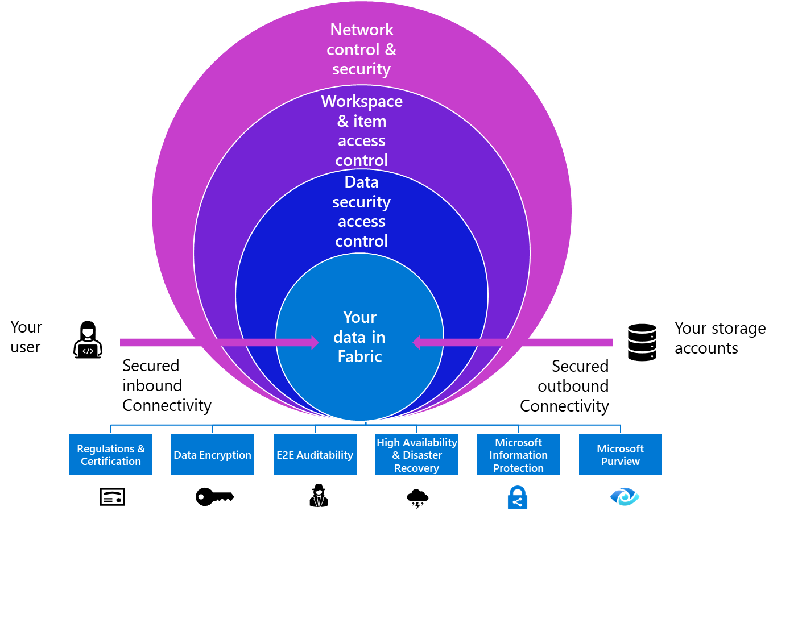
Manage Fabric Security
microsoft.com

Slide 41
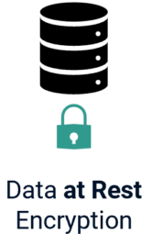

Data handling
Data at Rest
Encrypted by default using Microsoft-managed keys
Customer managed keys (CMK) is on the roadmap
Workaround: Use ADLS Gen2 and shortcuts
For Power BI you still have BYOK
Data in Transit
Across the public internet between Microsoft services: Encrypted by minimum Transport Layer Security (TLS) 1.2.
Inbound: Encrypted by minimum Transport Layer Security (TLS) 1.2.
Outbound: Enforces TLS 1.2, but can be configured to use TLS 1.0 if the external infrastructure doesn’t support newer protocols

Slide 42
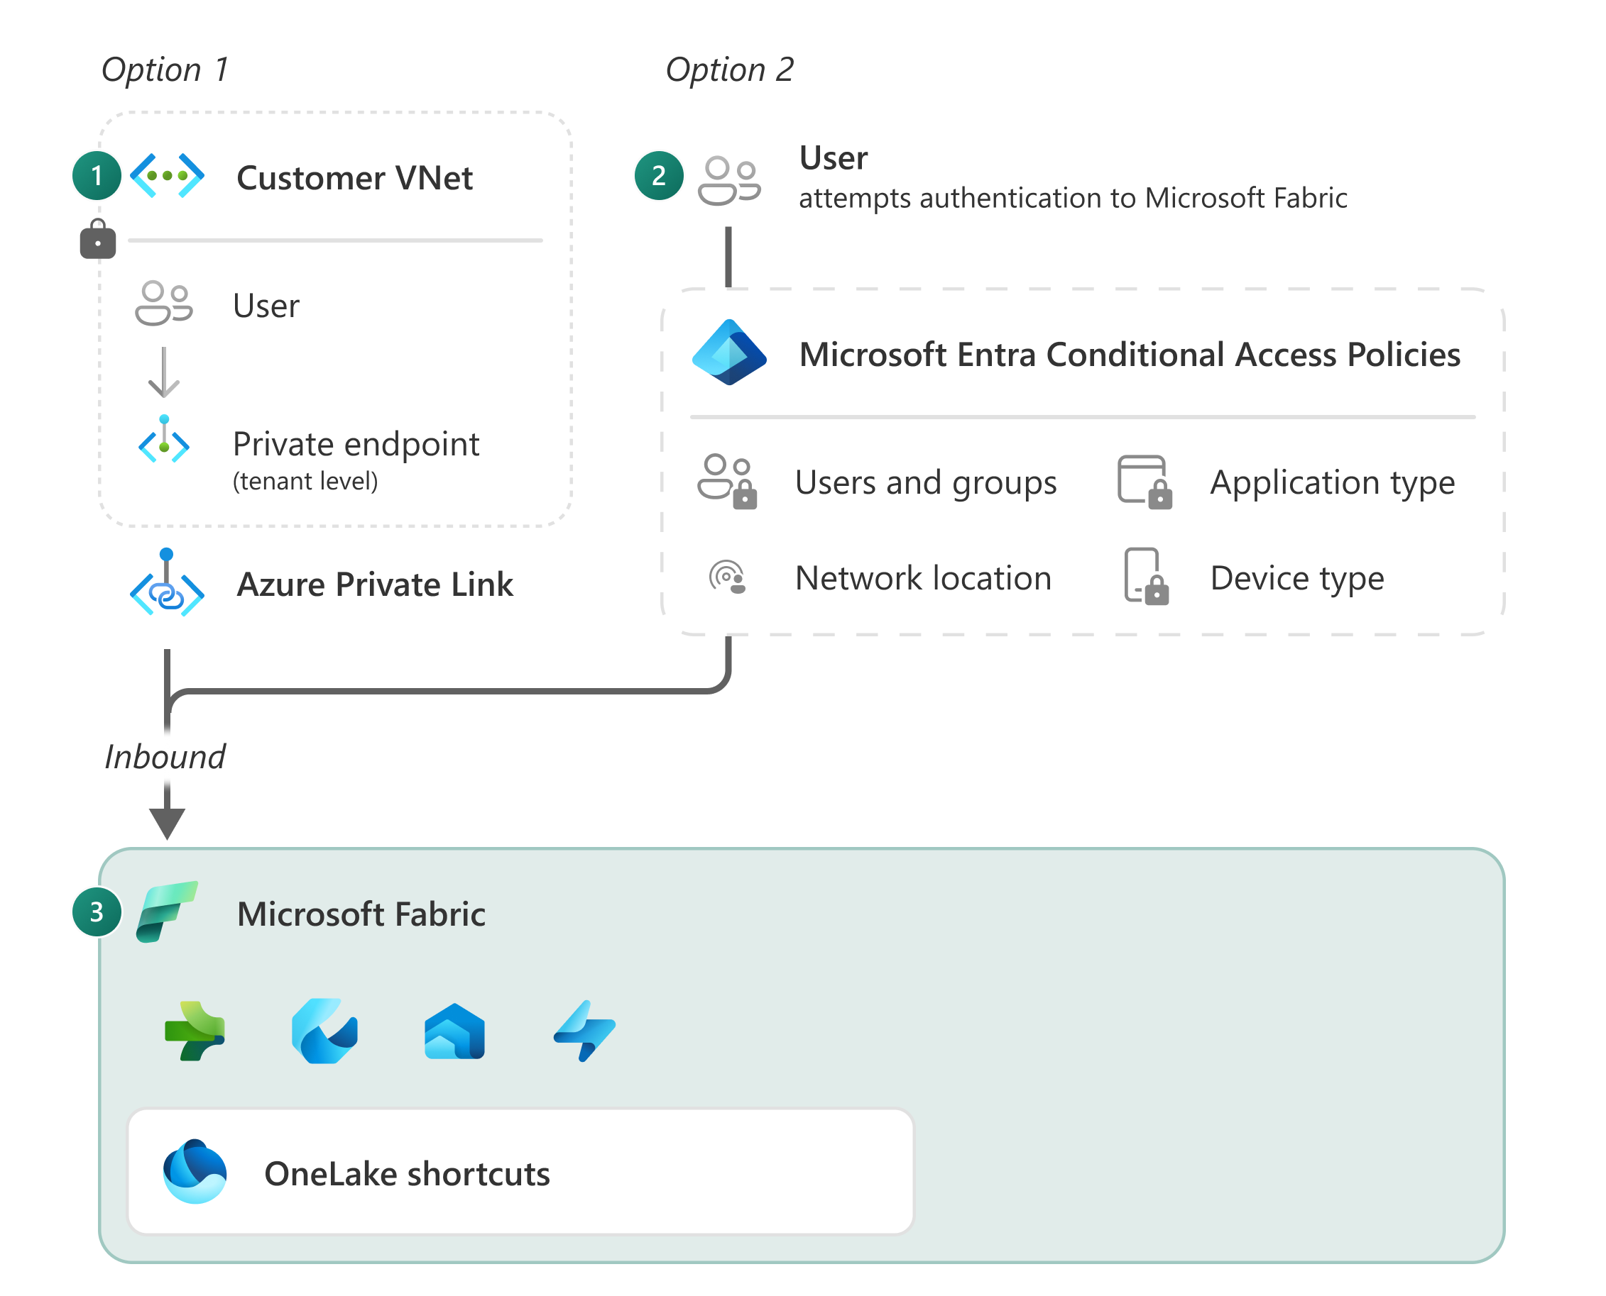
Secure inbound traffic
Private links
Uses a private ip-address
Requests follows the configured network path (VNet)
When you want to block all access from the public internet
Private link considerations
You need a VNet data gateway for all data behind the firewall.
Warehouse: No visual query and no copy data from and into a warehouse.
Power BI: No live connection to a semantic model and dataflow. No direct lake mode, no subscriptions and export to PDF.
Eventhouse: No ingesting data from OneLake, no connection from data pipelines, no shortcut.
F64 and higher

Slide 43
Secure inbound traffic
Entra conditional access
Access through the public internet
Microsoft Entra handles the authentication
Configure conditional access based on user, groups, device, IP location, application
Applied policy examples
Requiring multifactor authentication for users with administrative roles
Blocking or granting access from specific locations
Requiring organization-managed devices for specific applications

Slide 44
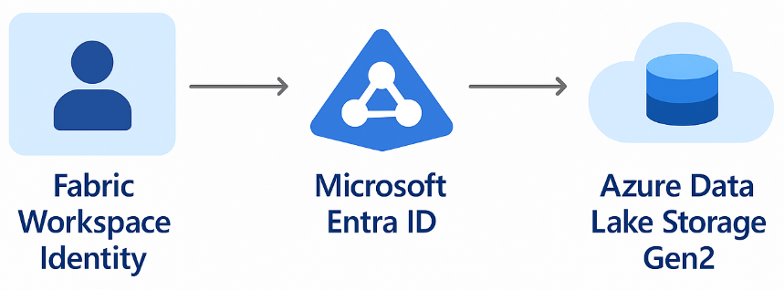
Secure outbound traffic
Workspace Managed Identity
Automatically managed service principal associated with a Fabric workspace
Why use it?
Connect item in workspace to external storages
Authentication for trusted workspaces (ADLS Gen2)
Considerations
Lifecycle tied to workspace
Admin rights required
Do not modify service principal directly

Slide 45
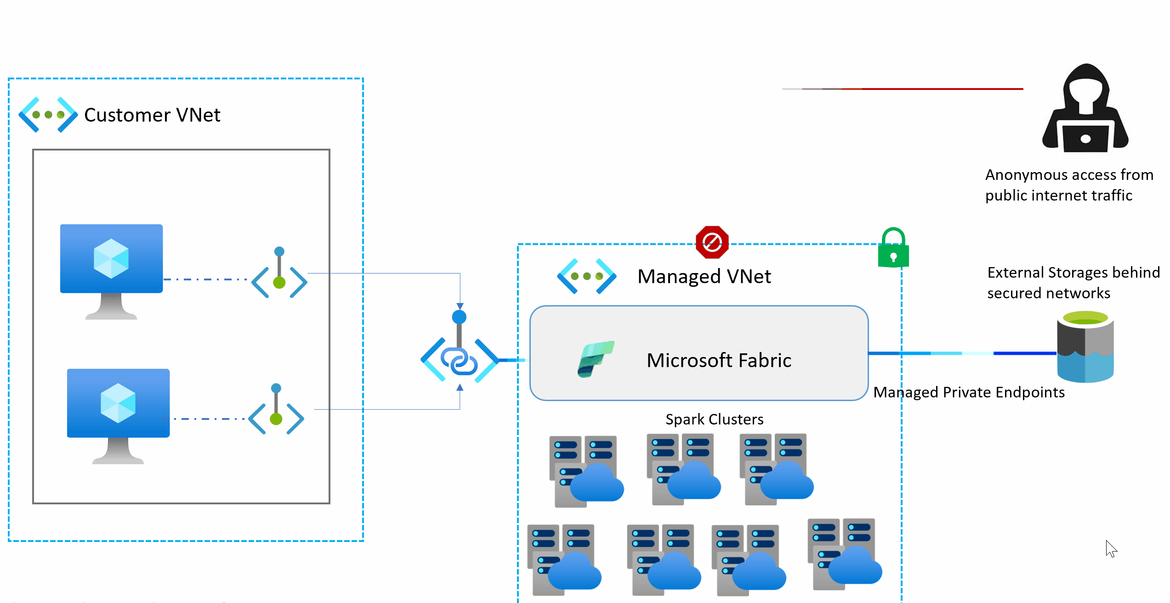
Secure outbound traffic
Managed VNets
Network isolation for spark workloads
The managed VNet is provisioned automatically when the job starts
No use of starter pools (pre-warmed clusters in a shared hosted VNet)

Slide 46
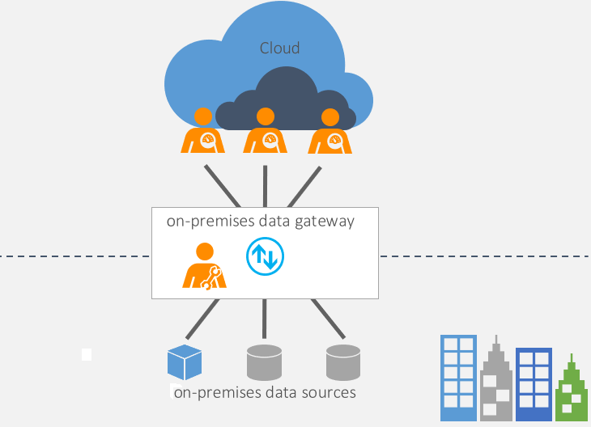
Data gateway
Why you need one?
Your data source is located on-premises
Your data source is located in a private network (like an Azure VNet)
You require a host for connector software (custom data connectors)
Which type of data gateway do you need?
On-premises data gateway (standard mode)
Virtual network (VNet) gateway
microsoft.com

Slide 47
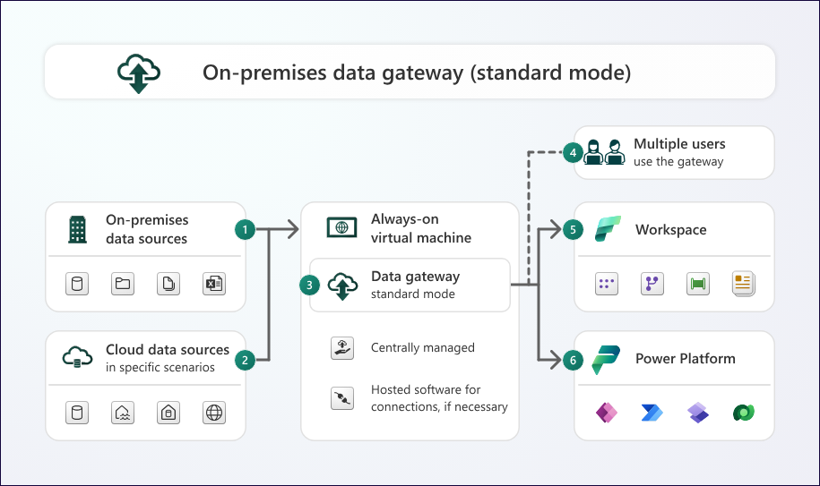
Data gateway
On-premises data gateway (standard mode)
The gateway transfers data from on-premises data source to cloud services.
The gateway transfers data from cloud data source to cloud services in specific scenarios like custom data connectors.
The data gateway is installed on an always-on VM.
4/5/6. Users can connect to the data sources behind the gateway
microsoft.com

Slide 48
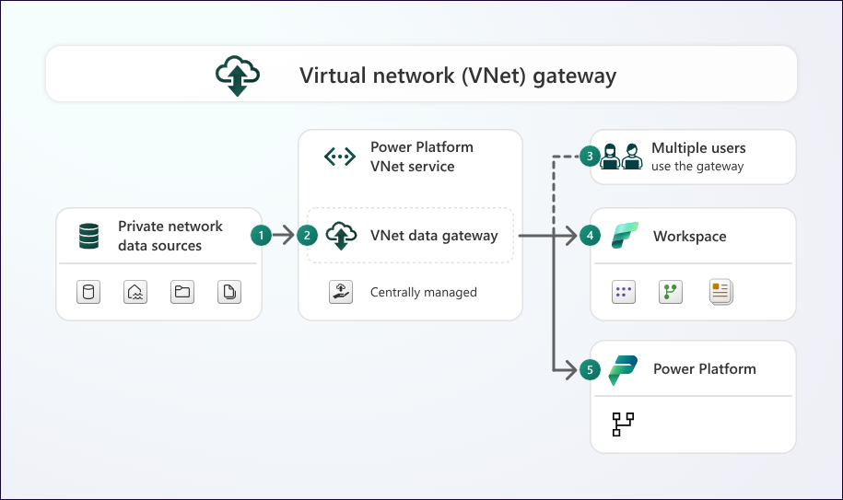
Data gateway
Virtual network (VNet) gateway
The gateway transfers data from data source in a private network to cloud services.
The VNet data gateway is a Microsoft managed service. You centrally manage the VNet data gateway from the Azure portal and the Power Platform admin portal.
3/4/5. Users can connect to the data sources behind the gateway
Typically used in in conjunction with private endpoints for Azure data sources to ensure that no traffic is ever exposed to a public endpoint.
microsoft.com

Slide 49
Data gateway
Why you need one?
Your data source is located on-premises
Your data source is located in a private network (like an Azure VNet)
You require a host for connector software (custom data connectors)
Which type of data gateway do you need?
On-premises data gateway (standard mode)
Virtual network (VNet) gateway
Other options to consider for on-premises data gateway:
Gateway cluster for better availability and performance
DTAP environments to split workloads
Consider the location of your gateway. Ensure residency requirements
microsoft.com

Slide 50
Fabric data security
Multiple layers of security and access control
Microsoft Fabric (OneLake)
Platform level access. Authentication through Microsoft Entra ID. Optional private link or conditional access.
Workspace
Workspace
Workspace level access. Managing artifacts and data access through these artifacts.
Compute security. User specific security applied during compute. e.g. RLS, OLS on a SQL analytics endpoint, warehouse), and semantic model
Files, shortcuts, tables
Files, shortcuts, tables
Item level access. e.g. ReadAll access on a Lakehouse or read access to only a subset of data within a Lakehouse (schemas, tables, rows, columns).
But what about OneLake level security?

Slide 51
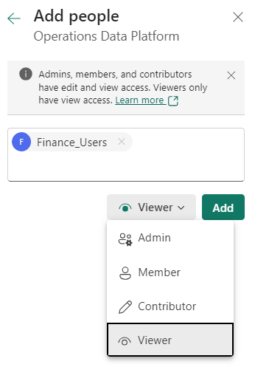
Workspace level access
Viewer
Can view all content in the workspace
Contributor
Can also modify content in the workspace
Member
Can also share content in the workspace
Admin
Can also manage permission and delete the workspace

Slide 52
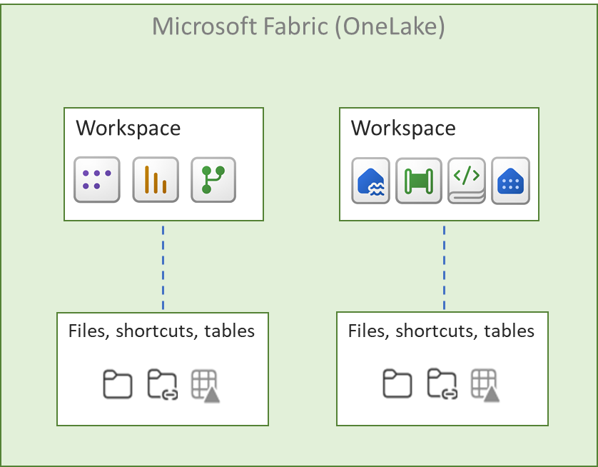
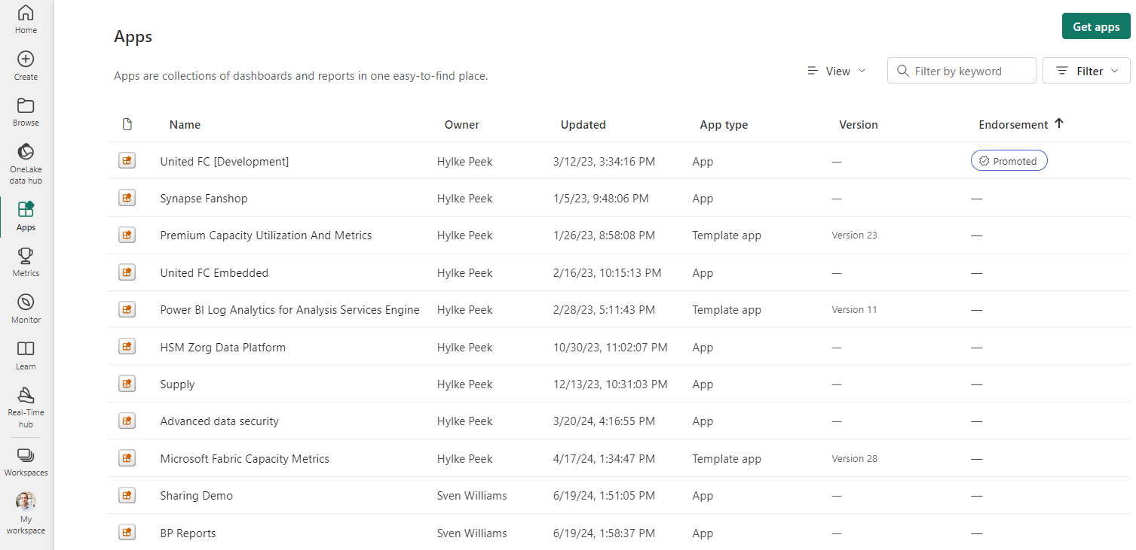
Access through apps
Preferred way to share reports within your organization
One place to develop reports, with the option to share with multiple user groups
No need to give permissions on the workspace
Users get read access on data
App

Slide 53

Compute security
SQL analytics endpoint and Warehouse
Column-level security
Restrict access to certain columns of a table, e.g. PII data
This only applies to queries on a Warehouse or SQL analytics endpoint
Use T-SQL to grant or deny permissions to roles
Row-level security
Restrict access to rows, e.g. only their department
This only applies to queries on a Warehouse or SQL analytics endpoint
Use T-SQL to grant or deny permissions to roles. This is similar to RLS in SQL Server
Dynamic data masking
Limit sensitive data exposure
Change sensitive data to untraceable values
Use T-SQL to apply masking.

Slide 54
Compute security
Semantic model
Object-level security
Restrict access to certain columns or tables, e.g. PII data
This only applies to queries on a semantic model
Use tabular editor to implement OLS
Row-level security
Restrict access to rows, e.g. only their department
This only applies to queries on a semantic model
Use Power BI desktop and DAX to implement RLS

Slide 55
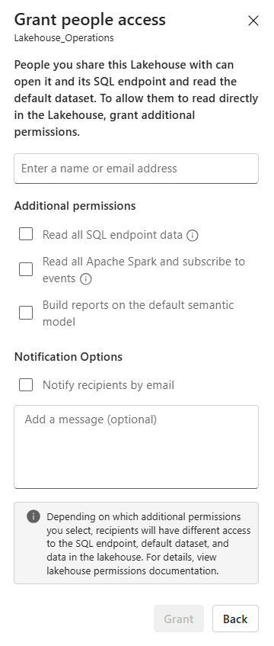


Item level access
Lakehouse
No additional permissions (Read)
No additional permissions (Read) and GRANT-permissions
SQL Analytics Endpoint
Lakehouse
Default semantic model
SQL Analytics Endpoint
Lakehouse
Default semantic model
User can connect, but can’t read any data
User can read tables for which he/she received GRANT-permissions.
ReadAll SQL Analytics Endpoint
ReadAll Apache Spark
SQL Analytics Endpoint
Lakehouse
Default semantic model
SQL Analytics Endpoint
Lakehouse
Default semantic model
User can read all tables with the SQL Analytics Endpoint.
User can read all files with Spark.
Build reports on the semantic model
SQL Analytics Endpoint
Lakehouse
Default semantic model
User can create Power BI reports on the default semantic model.

Slide 56
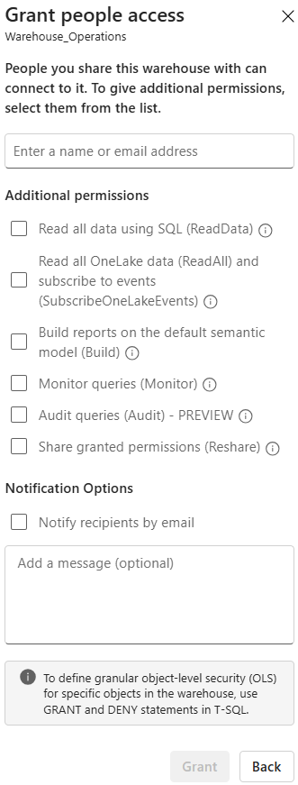
Item level access
Warehouse
No additional permissions (Read)
No additional permissions (Read) and GRANT-permissions
SQL Analytics Endpoint
Lakehouse
Default semantic model
SQL Analytics Endpoint
Lakehouse
Default semantic model
User can connect, but can’t read any data
User can read tables for which he/she received GRANT-permissions.
Read all data using SQL (ReadData)
Read all OneLake (ReadAll)
SQL Analytics Endpoint
Lakehouse
Default semantic model
SQL Analytics Endpoint
Lakehouse
Default semantic model
User can read all tables with SQL.
User can read all files with Spark.
Build reports on the semantic model (Build)
SQL Analytics Endpoint
Lakehouse
Default semantic model
User can create Power BI reports on the default semantic model.

Slide 57
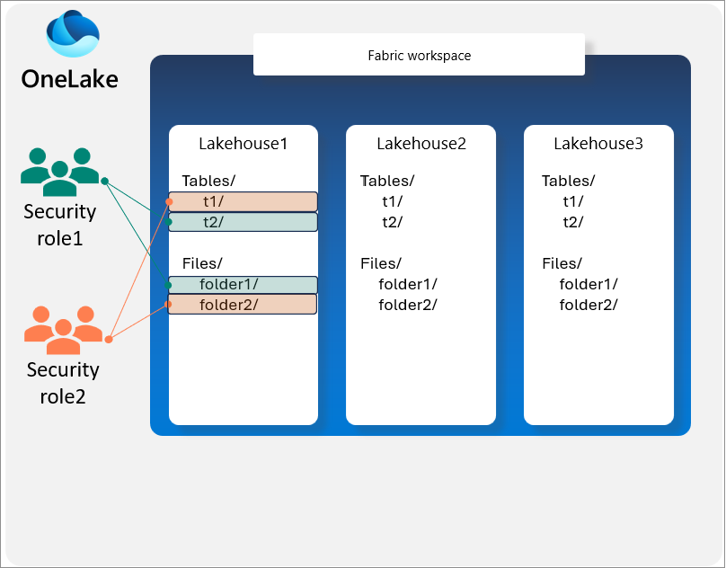

OneLake data access role
Grant access to specific folders
Lakehouse items only
Restricts access to user with read permission only
Semantic model
SQL Analytics Endpoint
Data access role security only applies to users accessing OneLake directly!
microsoft.com

Slide 58
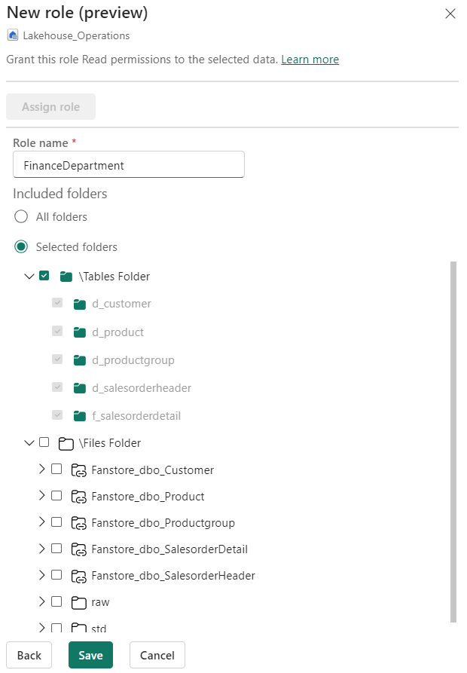
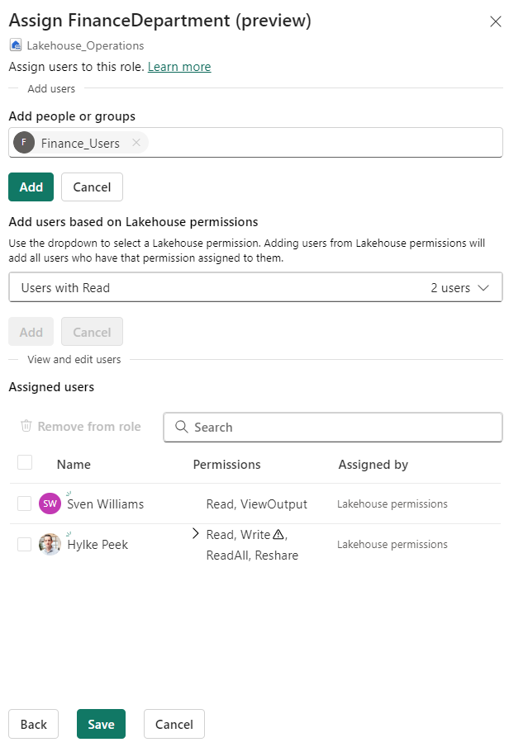
OneLake data access role
2. Assign people to this new role
Directly: Based on Entra-group or Entra-ID
Virtual: Based on Lakehouse permissions
1. Create a new role

Slide 59

Shortcut security
You need access on the shortcut location and on the target location
The most restrictive permission of the 2 locations is applied
Apply permissions to the shortcut location like any folder in OneLake, like Lakehouse sharing, OneLake data access roles etc.
For external authorization (including ALDS Gen2), one credential is used to secure the target location

Slide 60
Build permissions
Usage
Create reports
Analyze in Excel
Export underlying data
Usage XMLA-endpoint
How to get build permission
Workspace role
App audience
(Semantic model) Item permission
Share report
Request permission
Microsoft Fabric (OneLake)
Workspace
Build reports on the dataset
Files, shortcuts, tables

Slide 61

Collaborate with external users
Setup
Same as before with Power BI
Create guest user in your Entra
Guest user can get the same permissions as internal users
Microsoft Fabric (OneLake)
Workspace
Collaborate
External user
Files, shortcuts, tables

Slide 62
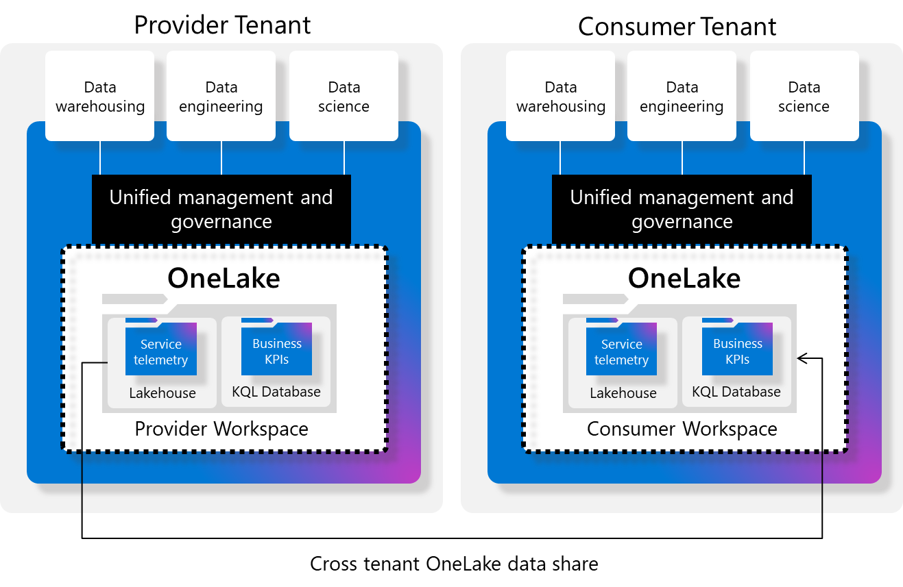
External data sharing
Share folders with external users
Data is not copied
Read-only access to the data
Other security policies should be defined in consumer tenant
No reshare within consumer tenant
Provider can’t control access in other tenant
Lakehouse and KQL database only
Data might cross geographic boundaries

Slide 63
Item level access + Column-level security for SQL analytics endpoint and Warehouse
Create a OneLake RBAC role and assign people

Slide 64
Security
Ask yourself the following questions
Why is the basic Fabric sufficient or do you need more inbound and outbound security?
Are you going to set up security at item level? And on which one?
Do you need OLS/RLS?
Would you also set up OneLake RBAC? For whom and why?
What workspace roles would you give to which groups?
Why do/don’t you need a data gateway?

Slide 65
Data Governance

Slide 66



Data Governance
Strategy
People
Process
Technology

Slide 67
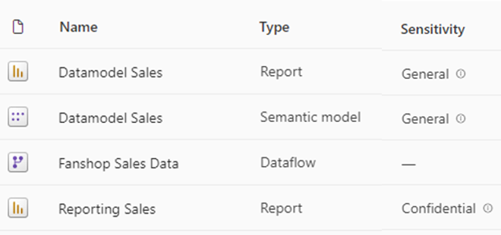
Sensitivity labels
Classify and protect your data
Different ways of labelling
Manual, default, and programmatic
Inheritance
Downstream and based on other item with label during creation
Export
Excel, Excel with live connection to Power BI dataset, PowerPoint and Power BI Desktop
Limitations
Never overwrites manually applied labels
Inheritance of data sources only works for semantic models with import mode

Slide 68

Endorsement and discovery
Identify your high quality and trustworthy data
Promotion
Promote your fabric item
Certification
This fabric item meets company standards
Master data
The data in this fabric item is a core source of organization data

Slide 69

Lineage and Impact Analysis
Identify potential impact when making changes
Find related Fabric items
All downstream items
Notify relevant people
Workspace contact list
Limitations
Only direct children for data sources
You don’t see names
Not on dataflows

Slide 70

Tags
Enhance discoverability
Categorize your items
Tags are created by the Fabric admin
Each item can have multiple tags
Limitations
Up to 10 tags for each item
Filter on tags only available in workspace

Slide 71

Metadata scanning
Catalog all metadata of your analysis and report items
Extract info about your Fabric items
Workspace, report, dataset, lakehouse, pipeline, governance, measures and more…
Make it more powerful
Combine this with the Power BI activity log
Limitations
No UI, just a set of api’s

Slide 72

Purview Hub
Create an overview of all items in your data estate
Catalog all your Fabric items
Workspace, report, dataset, lakehouse, pipeline, …
Metadata of your items
Creator, sensitivity and endorsement
Inventory
All items and details within Fabric
Limitations
To create a really good overview, you need more

Slide 73

Feature Usage and Adoption
Fabric utilization
Trends
Daily activity
Analyze
Per capacity, workspace, item
Counts individual users and groups
Inventory
A visual representation of your inventory

Slide 74

Content sharing
Create an overview of shared items in your data estate
High-level inventory page
Also available in other report
Analyze
Per capacity, workspace, item
Counts individual users and groups
Relevant questions
How often is an item shared?
Which items are shared on personal accounts?
Limitations
No access information on individual or group level

Slide 75
Sensitivity labels
Admin monitoring workspace

Slide 76
Data governance
Ask yourself the following questions
What is currently set up regarding data governance? Think about both strategy, process, people trained and technology?
What in Fabric can help you with this and how?

Slide 77
Development

Slide 78

Monitoring Hub
Monitor your activities
List of all succeeded, failed and in progress activities
Cancel (long-running) activities
Historical runs

Slide 79

GIT-integration
Why CI/CD?
Central source location
Version control
Track and merge changes
Automated deployments
Not all items can use Git.

Slide 80

Deployment Pipelines
Automated deployments
Friendly UI
Selective deployment
Limited compared to Azure DevOps

Slide 81

Automated deployment
Terraform
Infrastructure as Code
Version control
CI/CD pipelines for automated infrastructure deployments
Reusable moduls
Fabric Capacity
Name, region, SKU, admin
Workspace
Name, capacity, permissions
Lakehouse
Name, storage settings, permissions
Datawarehouse
Name, compute settings, backup policies
Pipelines
Name, activities, triggers
Notebooks
Name, code and markdown, scheduling
microsoft.com

Slide 82
Git-integration

Slide 83
Development
Ask yourself the following questions
Do the capabilities in Git with Fabric suit the current way of working?
If not, could you find a way in this to do work with Git in Fabric? Or what else do you need?

Slide 84
Recap

Slide 85

The Fabric Playbook: Managing, Maintaining & Delivering
github.com/hylkepeek
Hylke Peek

